Slide 1
OLA Virtual Annual Meeting Wednesday, April 28 7 p.m.
It’s Your Lake—Help Us Preserve It!
The meeting will start soon.
Thanks for your patience!

Slide 2
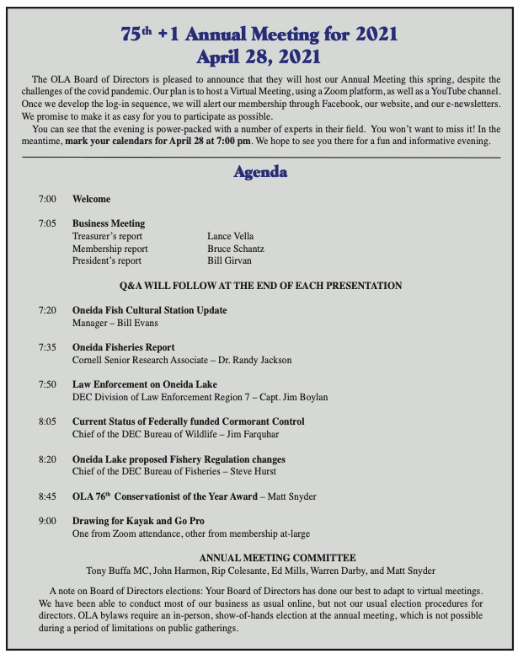

Slide 3
Treasurer’s Report April 1, 2020-March 31, 2021
Revenue: $36,585
Another good membership year
⬆️ donations
Expenses: $25,762
⬆️ membership mailings
⬇️ meeting and sports show expenses (canceled because of Covid)

Slide 4
Thank you to our sponsors and supporting businesses!

