Slide 1
New York State
Located on north shore of Oneida Lake in Village of Constantia
Primary function is raising walleye
Secondary production includes Lake Sturgeon, Round Whitefish, Cisco, Tiger Musky and Pure Musky.
Fish are stocked across NYS into public waters
Hatchery was built in 1992, approx 18k sq ft, including an office, visitor center, rearing room, research room and misc. rooms for mechanical equipment.
Water source is Scriba Creek, gravity fed to hatchery.
Open daily April 1-Sept 1 8am-3:30pm and tours are available. Covid Closure

Slide 2
2019 2020 2021 Walleye Collected - 16,620 3,845 12,424 Females Used - 5,816 1,605 5,190 Eggs Collected - 324M 88.65M 271.2M Nets Set - 9 4 7

Slide 3
·Adults are hand stripped into a mixing bowl using 2 males to 1 female preferably, but due to lack of males this year, we used a 1:1 ratio after the first day.

Slide 4
12.55lb 28” Female

Slide 5
·Eggs are mixed with tannic acid to remove adhesive coating, rinsed and water hardened for 1 hour. ·While water hardening they are disinfected with iodophor. ·They are then placed into McDonald type incubation jars with flows of 1-2gpm. ·This year we saw 52,254 eggs per female

Slide 6
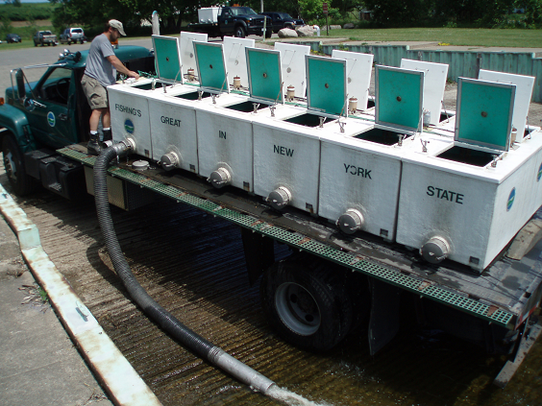
·Eggs incubate for ~21 days, formalin is used daily to control fungus. ·Majority of fry are stocked immediately after hatching. ·Oneida Lake is stocked using a pontoon boat. Other waters and transfers to other hatcheries are via truck.

Slide 7
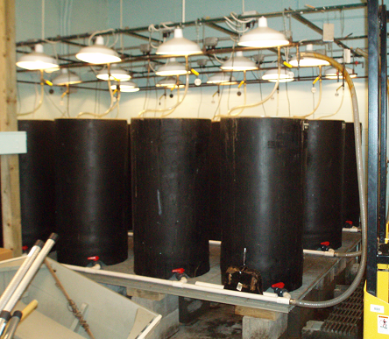
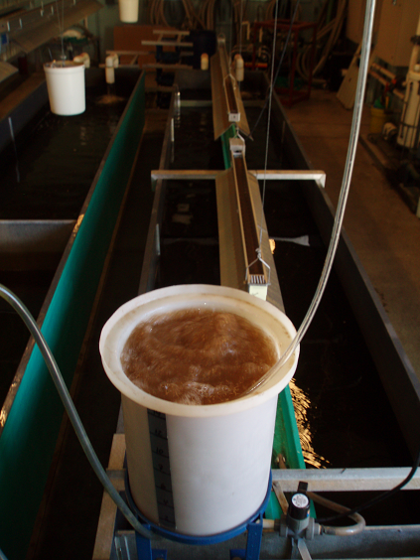
-- 275,000 fry will be kept at Oneida for intensive culture
Immersed in an Oxytetracyline (OTC) bath to mark otolith.
Stocked into 15 indoor raceways (25’ X 45” X 2’ ~1400gal)
Fry will be fed live brine shrimp for 35-50 days and then stocked at 1.5”.

Slide 8
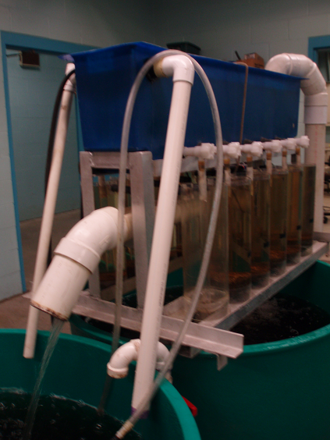
Lake Sturgeon
Eggs collected from wild fish from the St. Lawrence River and delivered to Oneida Hatchery and the Genoa National Hatchery in Wisconsin
Eggs are incubated in McDonald jars with 1-2 gpm flow.
Oneida Hatchery Stocks…
Oneida Lake – 500 fish
Cayuga Lake – 2500 fish
Genesee River – 1000 fish
6 other NY waters are stocked
with the fish from Genoa.

Slide 9
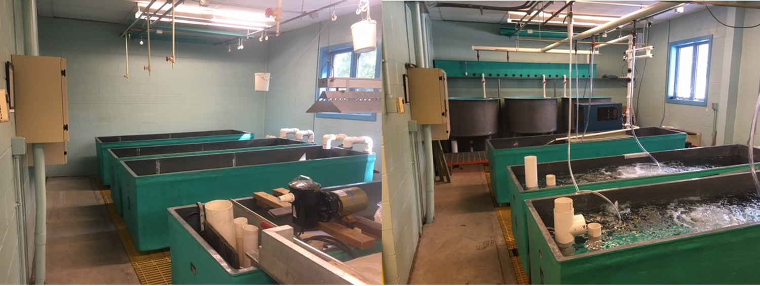
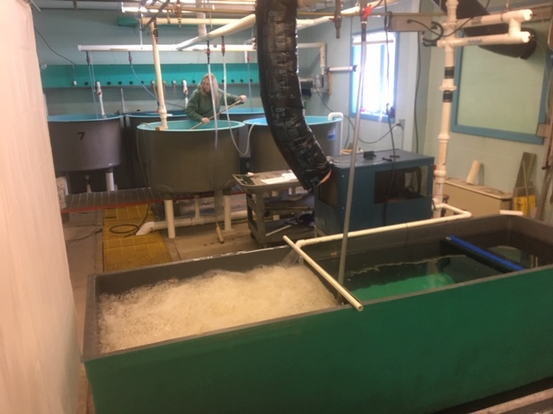
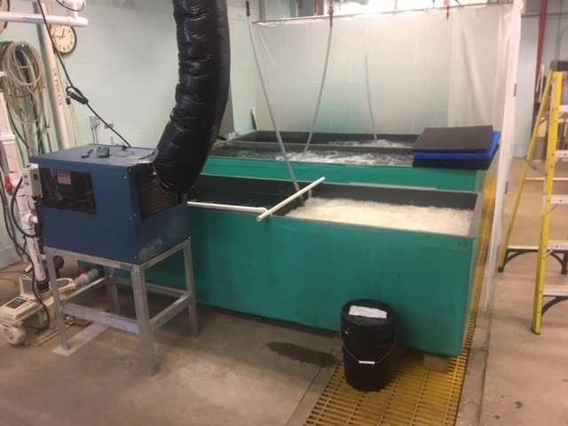
Cisco Before…After

Slide 10
More Species
Due to South Otselic Hatchery taking Rome Brood Stock, Tiger Muskies will be coming to Oneida Hatchery. This year will be a test run with a couple tanks and if all goes well, we will take on the full production next year.
SUNY ESF has requested that DEC help raise pure strain muskellunge. We will raise 30,000 up to 3” and then transfer them to South Otselic Ponds.

Slide 11
Species Reared at Oneida Hatchery
Walleye – 207M fry - 165,000 50 day Fingerlings
Lake Sturgeon – 4,000 7”+ fingerlings
Cisco - 15,000 3” raised in Recirc
Round Whitefish - 15,000 1” raised in Recirc
Muskellunge – 30,000 3”
Tiger Musky – 20,000 7”- 9”

