Slide 1
Problem Management of Canada Geese in a Suburban Township.
Jim Eckler, Bureau of Wildlife, Region 8, Avon
Notes:
Started in Fall of 2000; suburban wildlife management challenge and a community-based solution

Slide 2
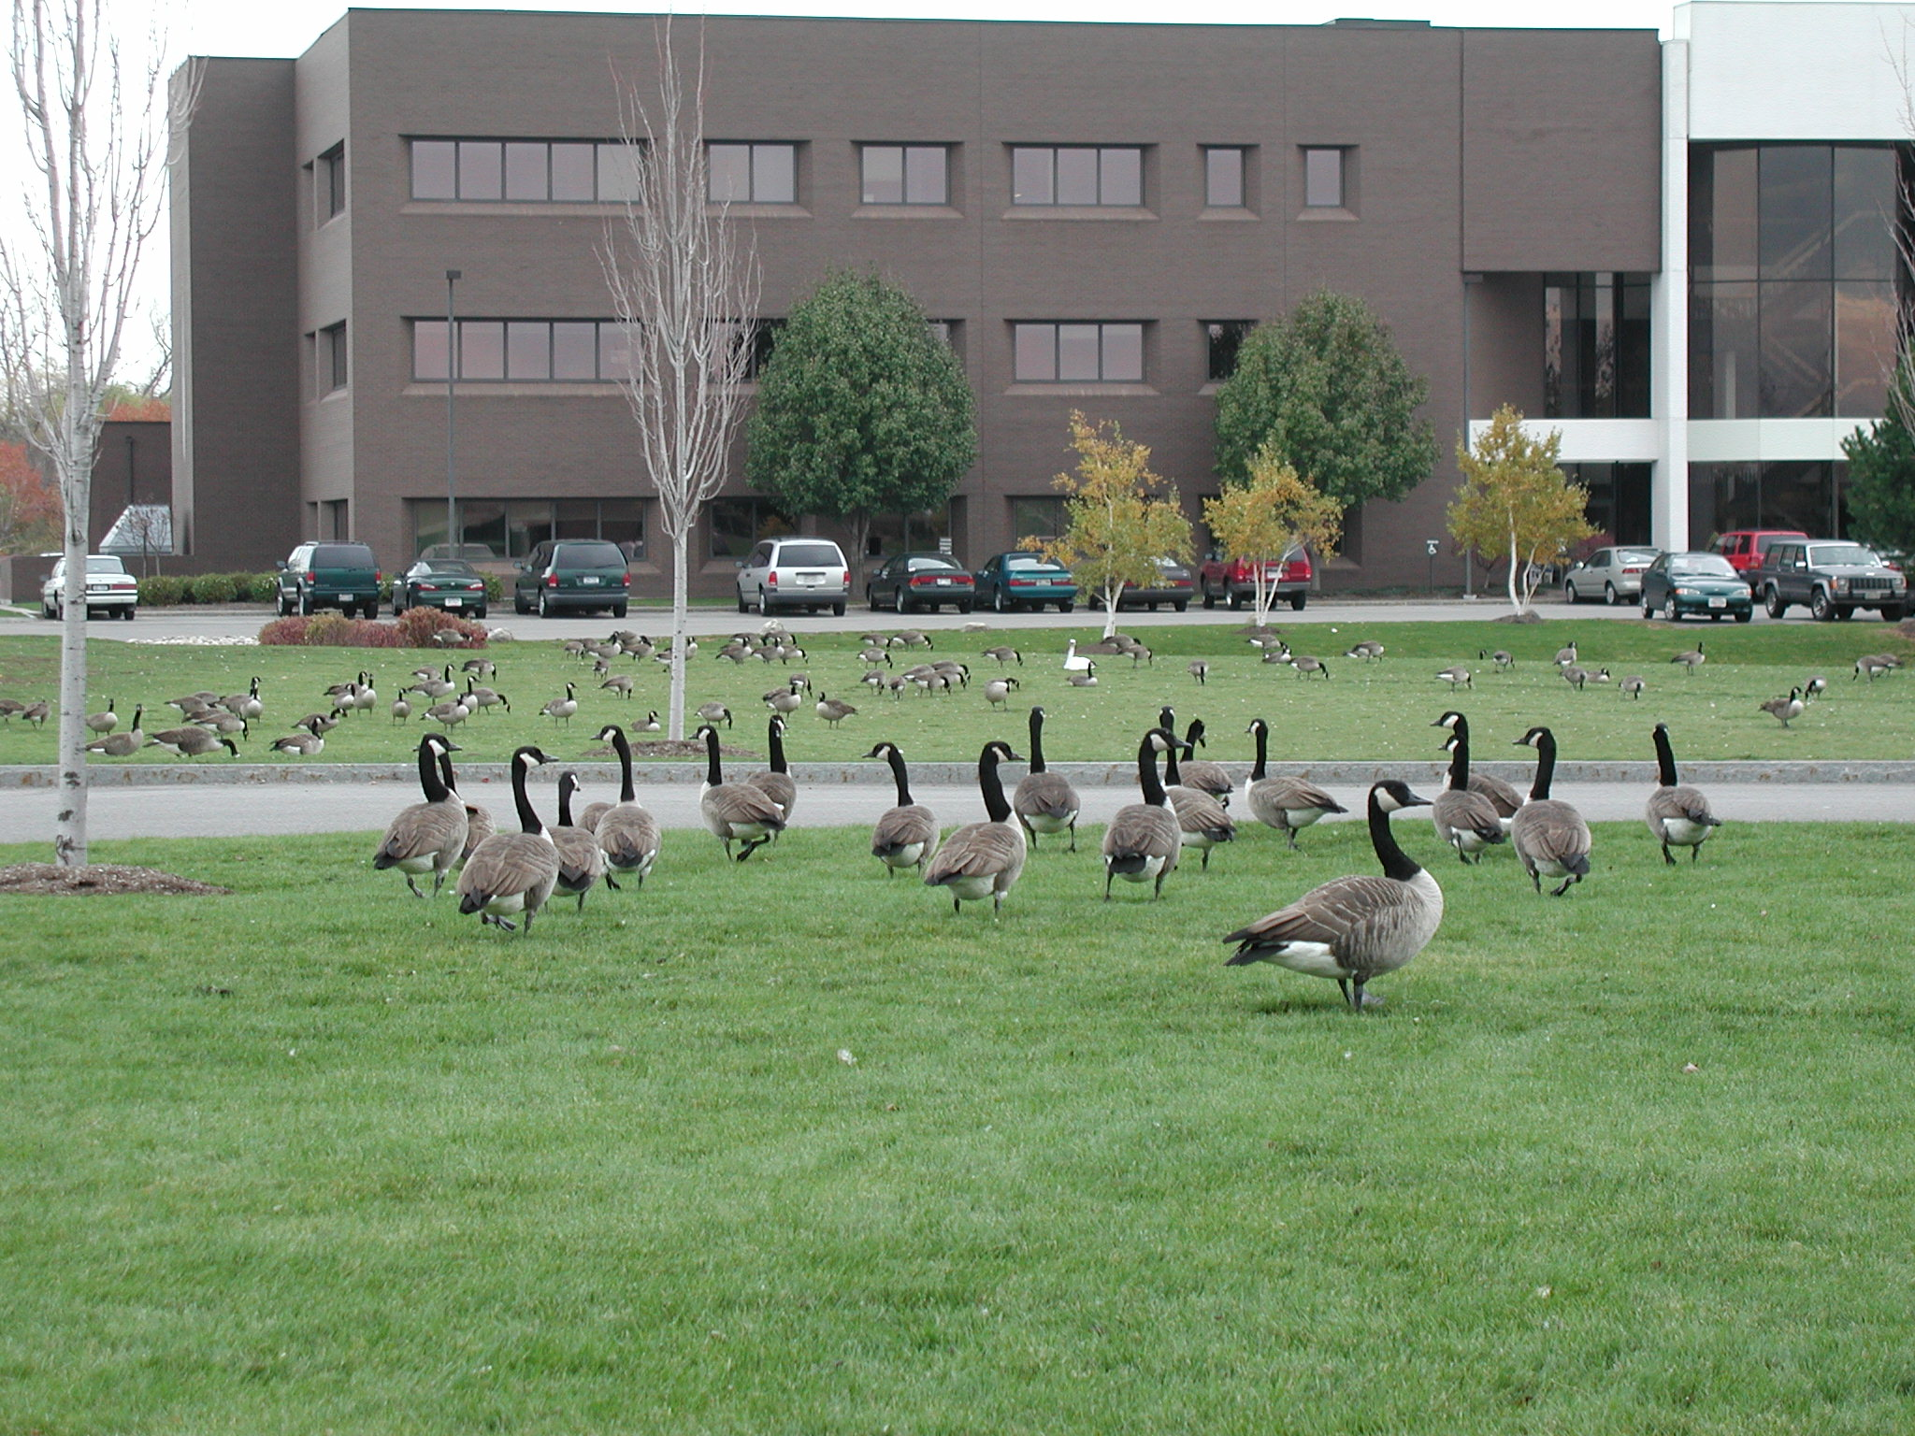
“A symbol of the great outdoors and crisp fall days has become a gluttonous bad-tempered, loose-boweled trespasser.”
Notes:
Too much of a good thing:

Slide 3
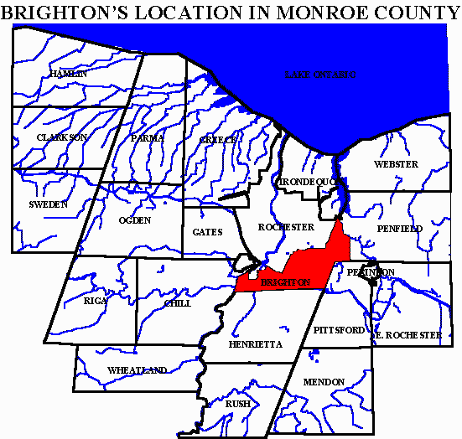
Town of Brighton
15.6 square miles
35,000 residents
1/4 park/open space
Gun discharge ordinance
300 geese
Notes:
Residential – borders City of Rochester; about 1 resident per ¼ acre.
office complexes
Erie Canal
300 resident geese initially

Slide 4
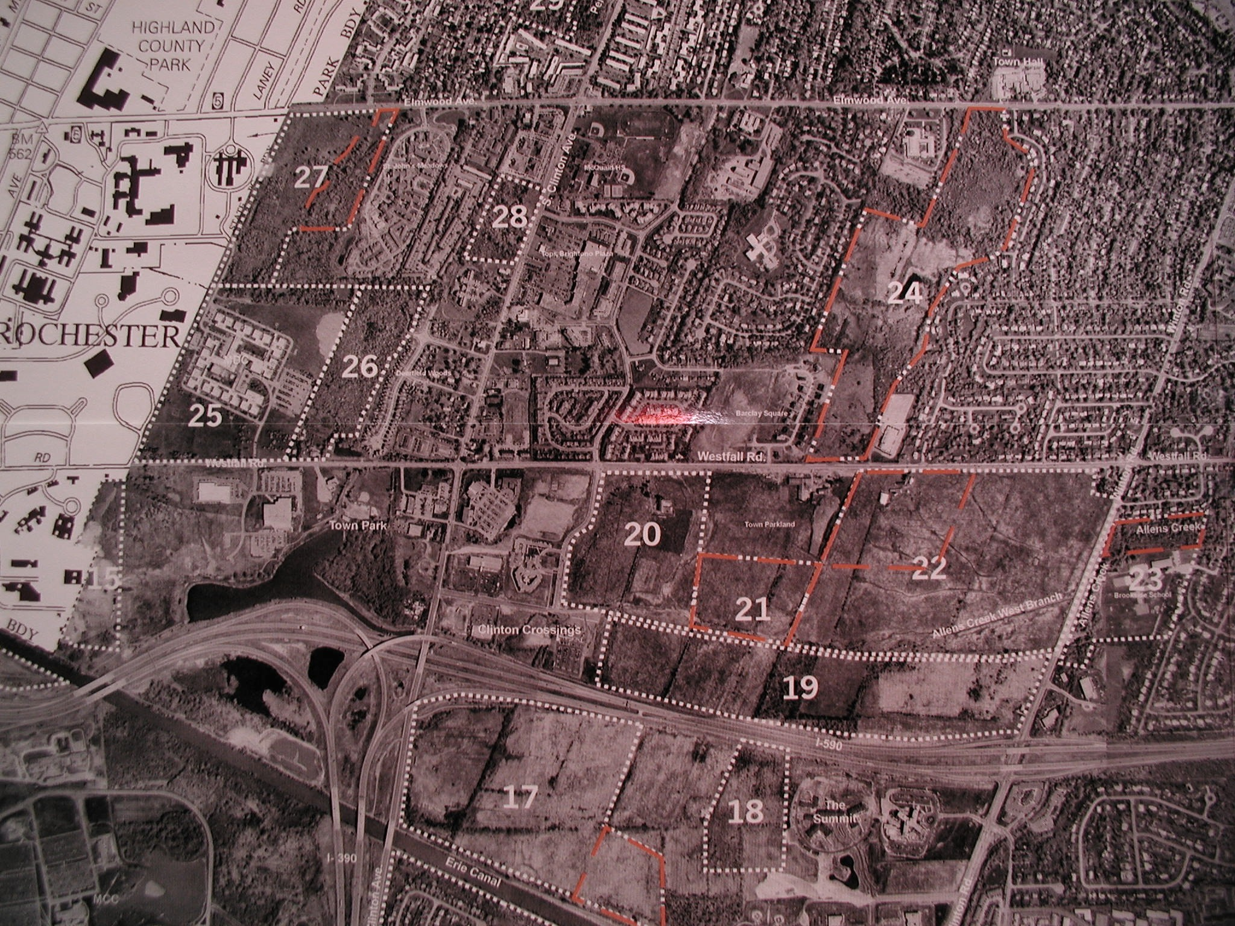
Farash Wetland
Lac de Ville
Town Park
390 / 590
Meridian Center
Notes:
Important to addling program:
Nesting habitats (shown in white) identified near problem sites (shown in yellow).
Describe each: pond size?

Slide 5
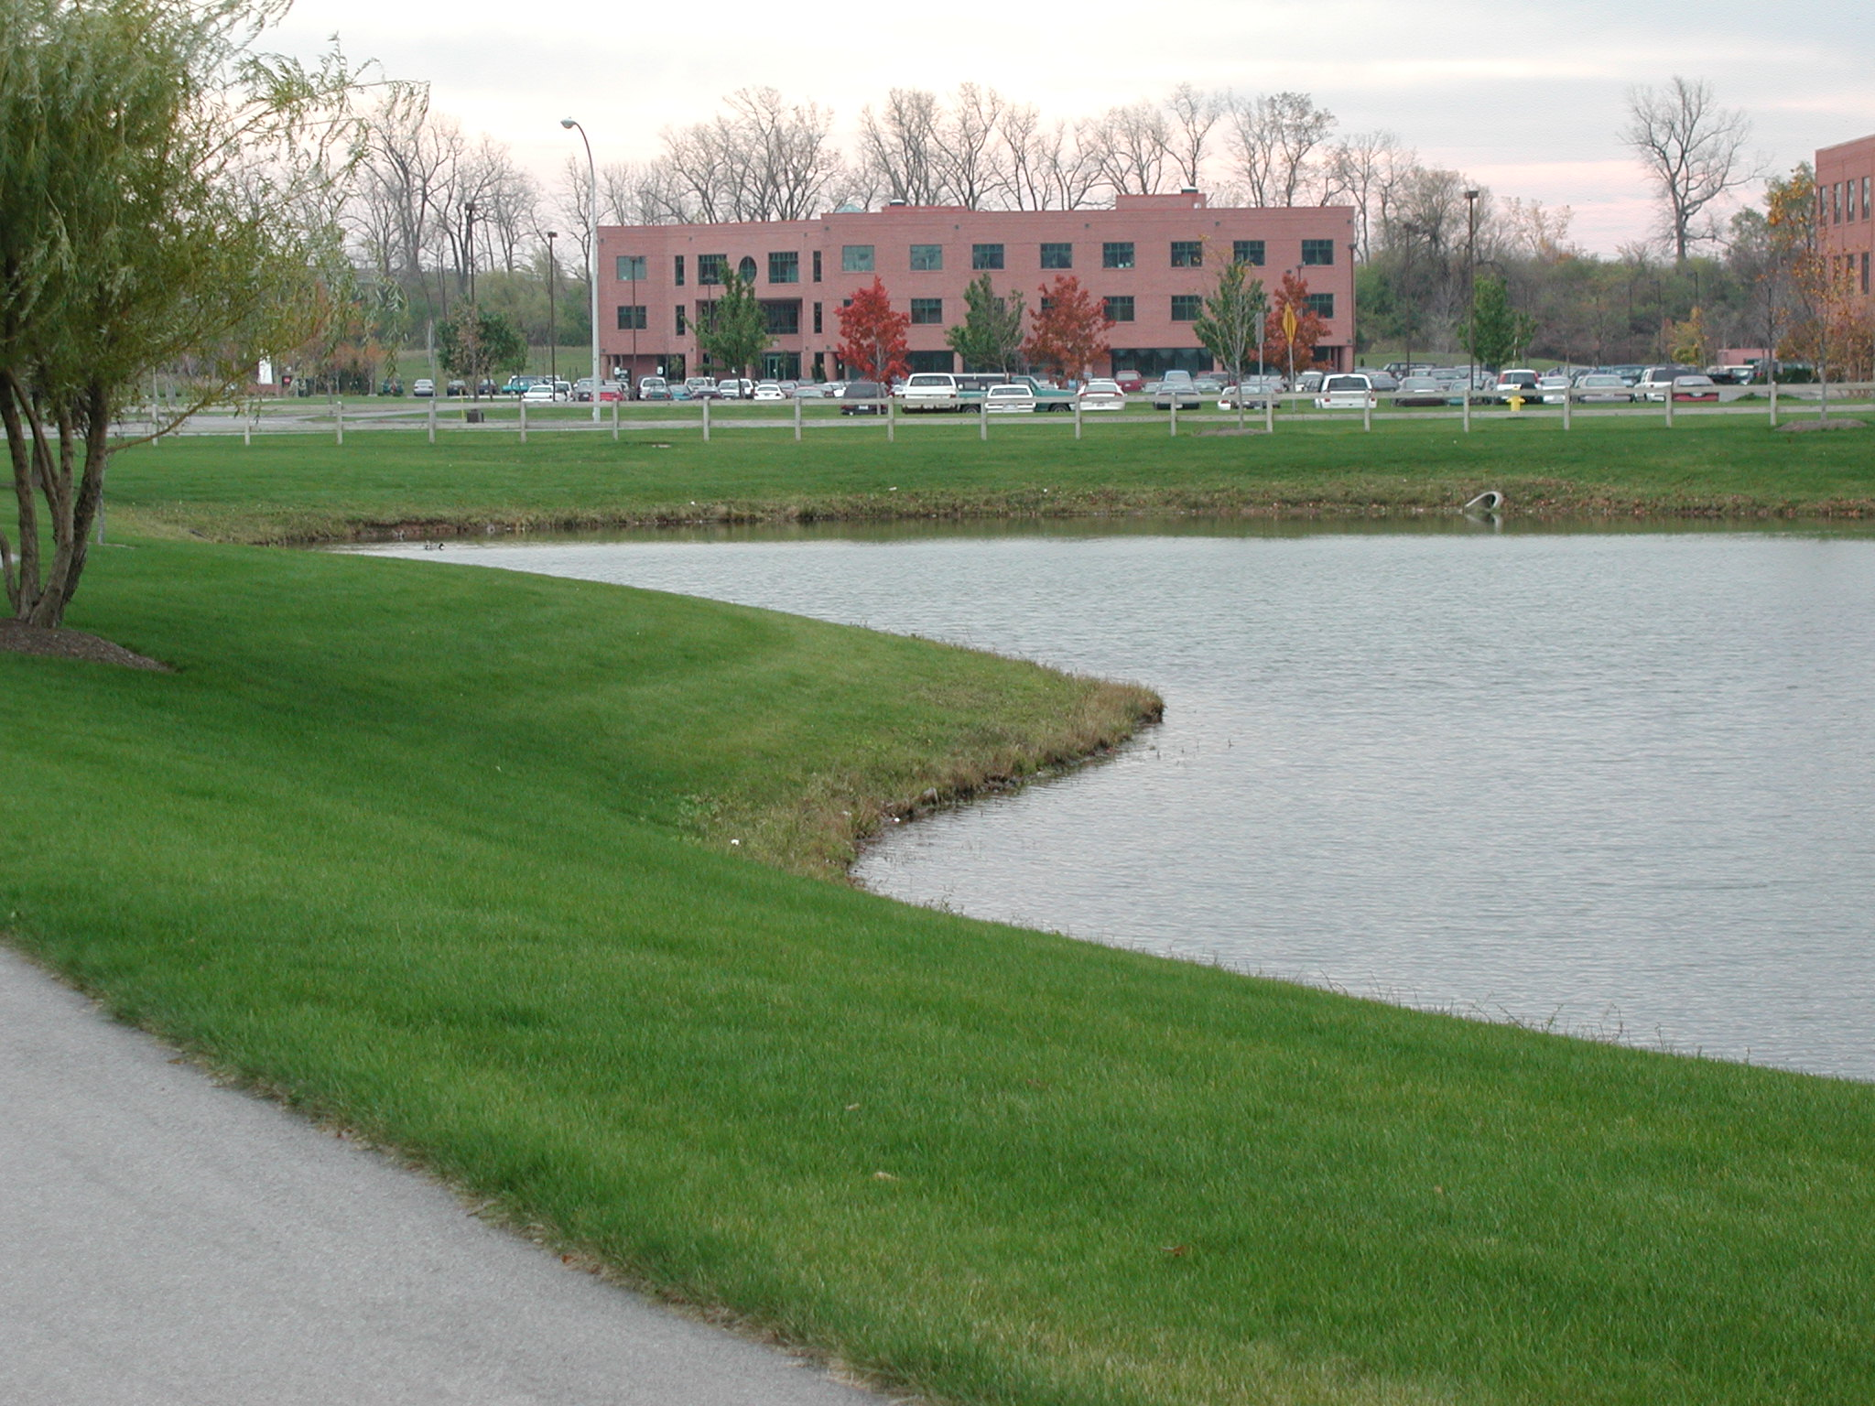
Meridian Center
Notes:
Meridian center
classic mowed shoreline, no cover.
Also trouble at public and private schools.

Slide 6
Complaints
Traffic risks
School playground, fields
Over grazing lawns
Slippery sidewalks
Aggressive nesters
Notes:
Street sweeper.
So the Town had a public meeting…
over grazed lawns
defecate every 7 minutes, 1-2 pounds a day
slippery green goo on sidewalks
traffic problems
nutrient loading in ponds
public health concerns: bacterial pathogens, parasites
(Salmonella, Listeria, Giardia, Cryptosporidium, Chlamydia) Rare zoonosis.
aggressive behavior by nesting birds
airports

Slide 7
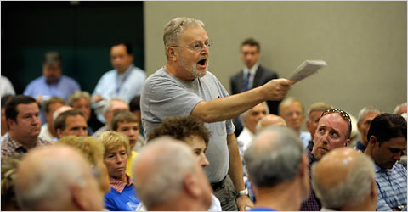
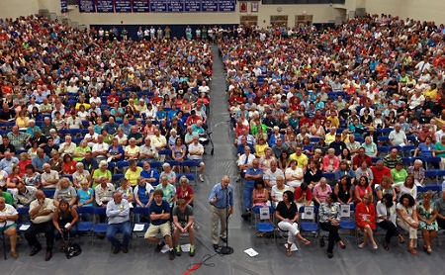
Public Meeting
Notes:
Televised; 75 attendants
A task force was convened and charged with writing a town plan
24 members
5 active participants
Monthly meetings
Geese Peace
Task Force made up of residents primarily, also conservation chair of bird club, Animal welfare, humane society members, animal rights group.
From Town: Town Board Member, Highway supervisor, Director of Public Works, Animal Control Officer
Sportsmen not represented.. Not classic task force set up…
not all interest groups represented.

Slide 8
Brighton’s Comprehensive Plan
Objective-based
Identified problems and sites
Recommended 4-points of action
Timeline
Evaluation
Notes:
…and public outreach

Slide 9
Abatement Techniques
No Feeding
Encourage Hunting
Modify Habitat
Wire or line Grids
Fencing
Remote Control vehicles
Laser
Sterilization
Noisemakers
Repellents
Dogs
Egg Oiling
Capture and remove
Decoys – swans, alligators
Fountains

Slide 10
Abatement Techniques
No Feeding
Encourage Hunting
Modify Habitat
Wire or line Grids
Fencing
Remote Control vehicles
Laser
Sterilization
Noisemakers
Repellents
Dogs
Egg Oiling
Capture and remove
Decoys – swans, alligators
Fountains
Notes:
Specific to the sites, the residents

Slide 11
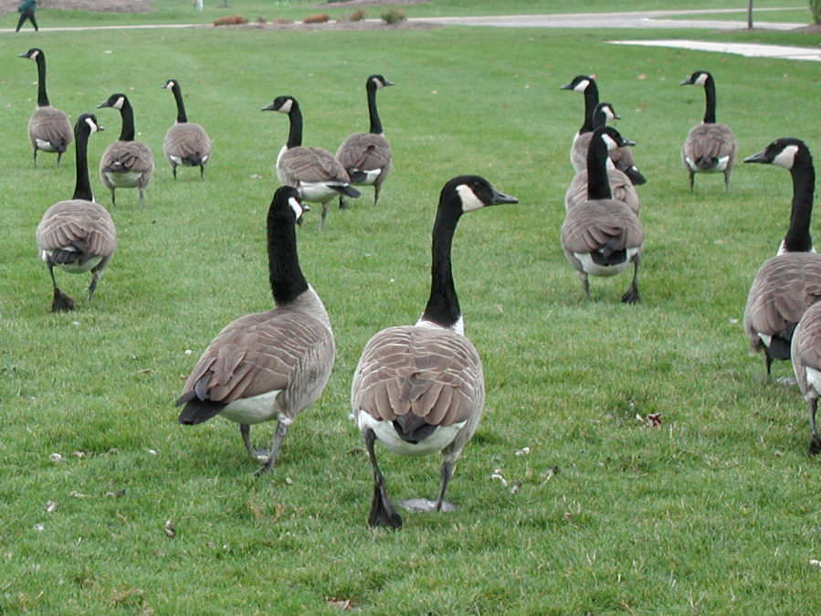
Plan did not include:
Pyrotechnics
Flagging/balloons
Removal of domestic geese
True fence
Hunting/Round-up
Notes:
Town Plan did not include...
Site specific concerns.

Slide 12
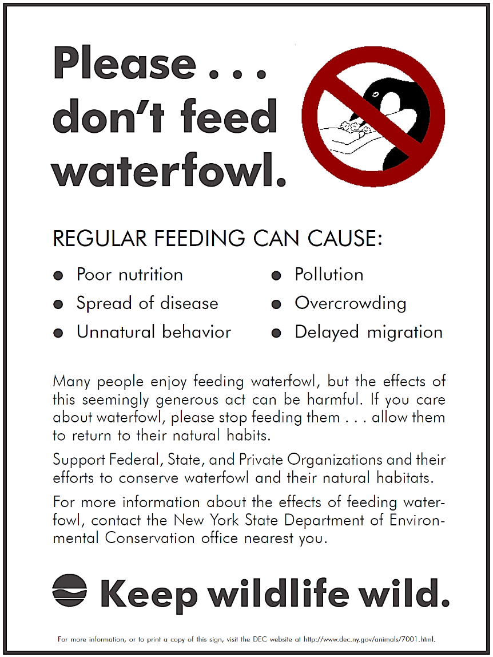
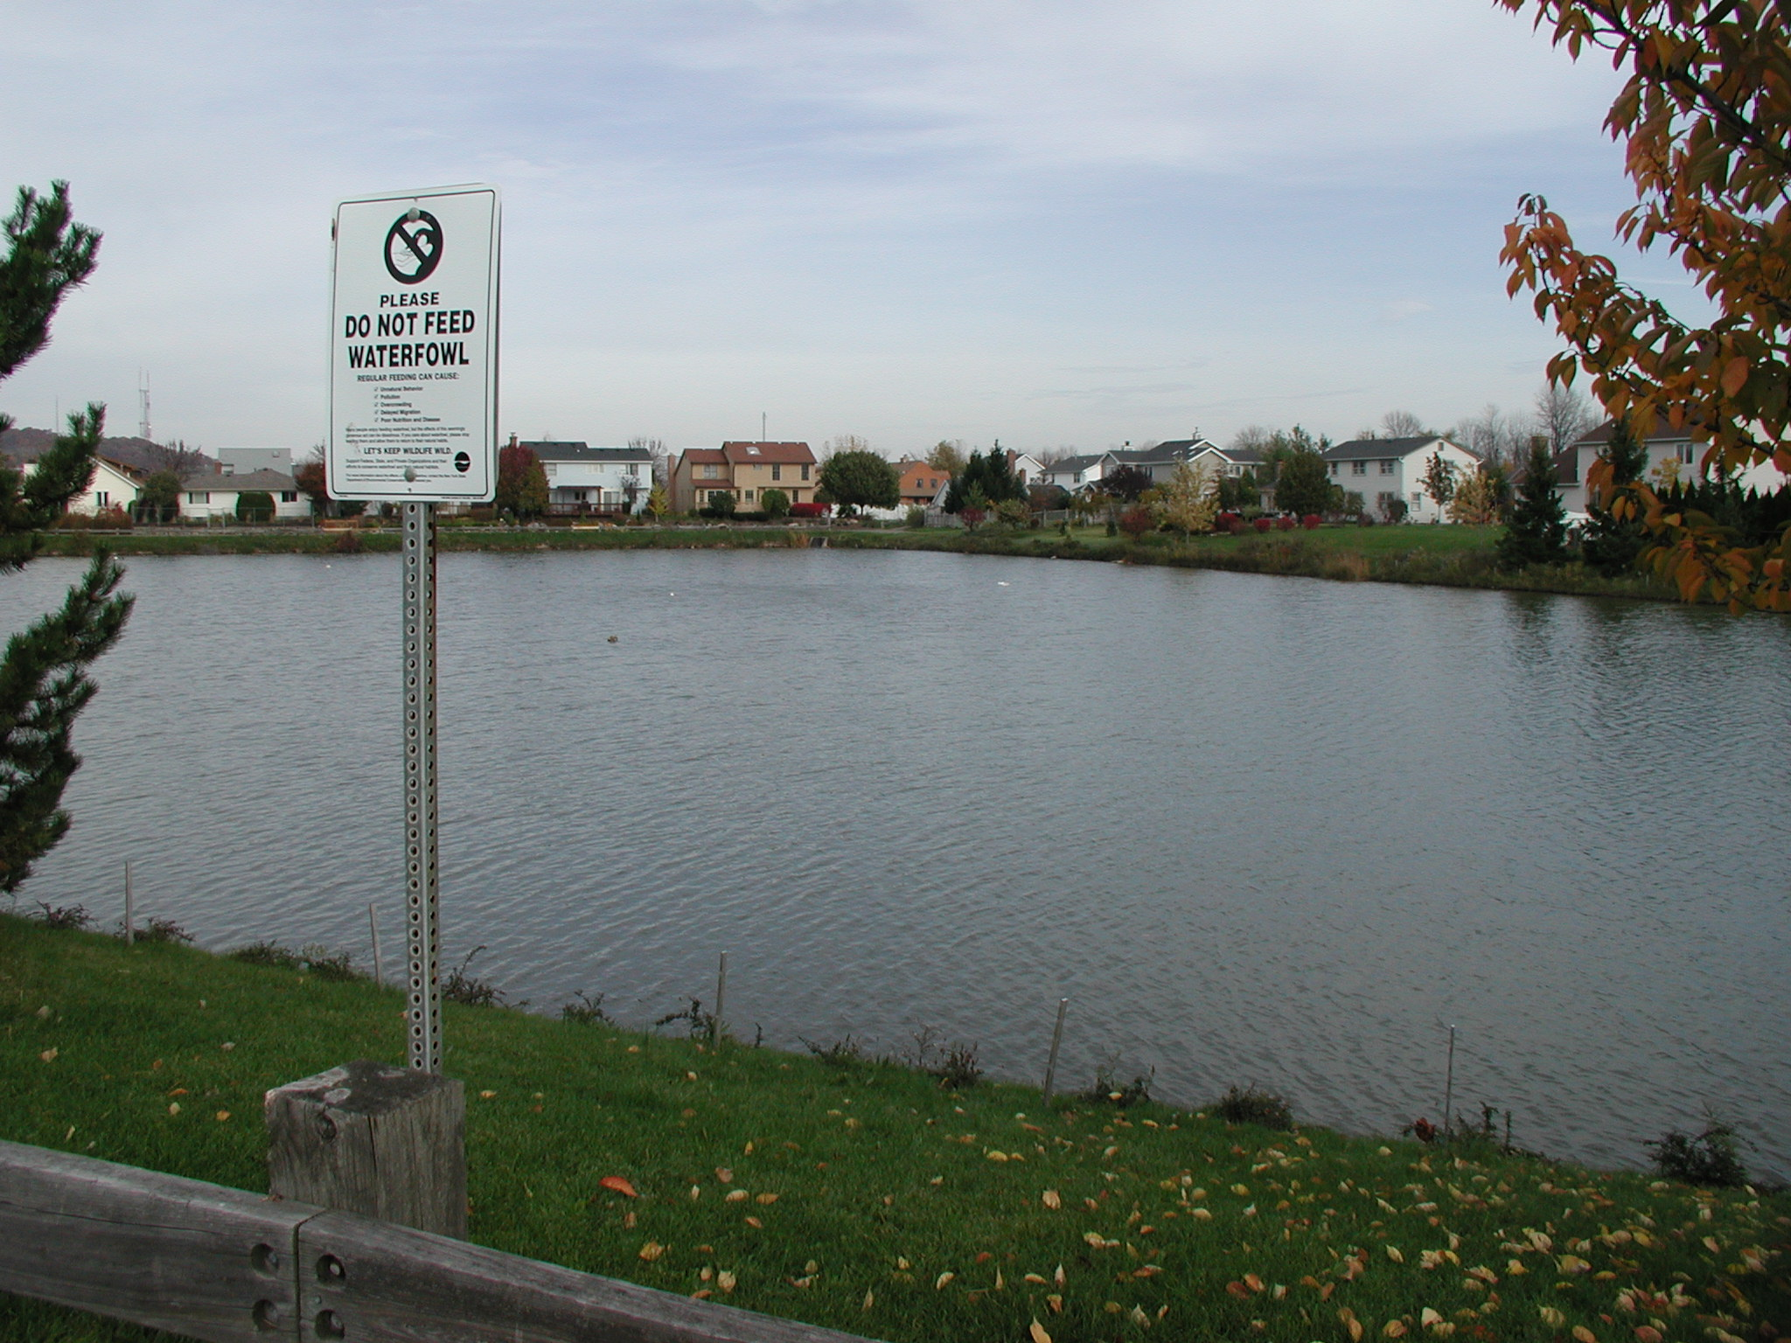
Brighton’s Comprehensive Plan
Site alteration
  Monofilament fence
  Plantings
No feeding
  Signs
  Ordinance
  Direct contact
Lac de Ville
Notes:
Objective-based, periodically-reviewed plan
Looking at each component of the plan, one at a time….
Site alteration at Lac de Ville
not silt fence - unsightly
3 strands of monofilament: 6, 12 and 18 inches (later removed)
cottoneaster plantings
$8,000 cost to town (But there were costs before plan- street sweeper.)
No feeding
signs (list reasons) available at Voss Signs, Manlius, NY
town ordinance passed
illegal on town lands
penalty- fine or community service (cleaning)
direct contact with offenders - letters, phone calls

Slide 13
Brighton’s Comprehensive Plan
Egg oiling
Followed HSUS protocol
FWS and DEC permits (now website registration), landowner permission
Training: 10-12 college students, Zoo, Town Animal Control and task force members
  How-to
  Equipment: corn oil, umbrella, waders, data sheets, ID cards
Notes:
Egg addling:
geese are indeterminant nesters… if you remove eggs they will lay more.
Light coating of corn oil prevents interchange of gasses through egg shell
documents: waivers of liability, id cards, landowner permission, data sheets

Slide 15
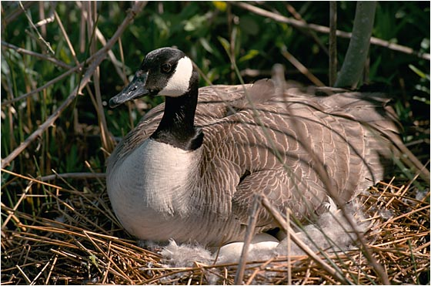
Egg oiling results – Year 1
Treated 31 nests
190 eggs
100 person-hours
70% decrease in goslings at Lac de Ville
Notes:
Initial visits 4/14/2001, revisits on 4/21 and 4/25.
About 105 person-hours, 2 or 3 visits made to each nest.
3 nests were known to be partially successful, 9 eggs were untreated
Lac de Ville reported 9 goslings as compared to about 30 year before.
27 of 31 nests were from 2 sites.
Estimated hatch date was 5/16 to 5/26
markers didn’t work…

Slide 16
Egg Oiling Results

Slide 17
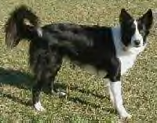
Brighton’s Comprehensive Plan Herding dogs
3 sites
1 or 2 visits/day
6 months
Notes:
Trained border collies chase and scare geese, do not harm them.
Geese Control of NY.
About $8,000 - $10,000
6 months… April to Oct, Not during molt (July).
kept counts too
also used remote control boat
gained private contracts with 2 other nearby sites in Brighton. Identified presence of sites that could handle more geese… alternative sites for geese

Slide 18
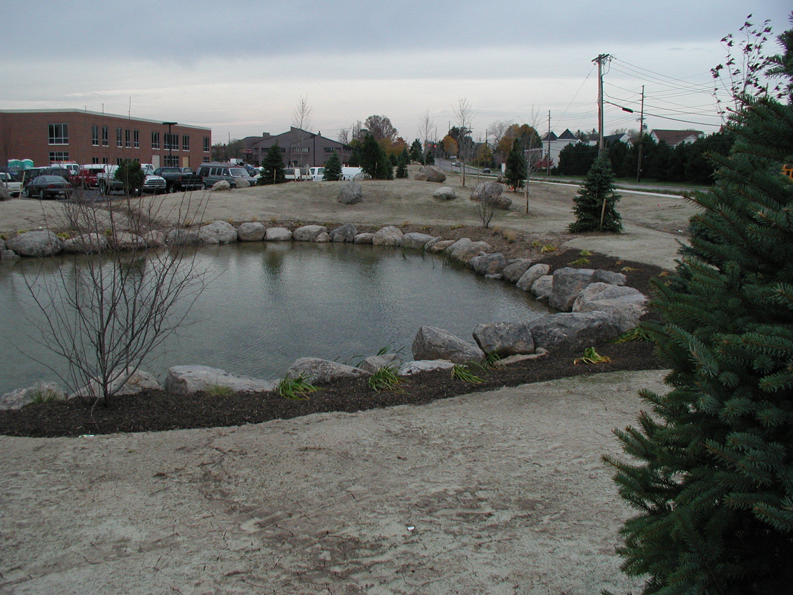
Brighton’s Comprehensive Plan Development guidelines
Rocky shoreline
Landscaped
Notes:
Followed information from:
“Habitat Modification and Canada Geese - Techniques for
mitigating human/goose conflicts in urban and suburban environments.”
by D. Doncaster and Jeff Keller

Slide 19
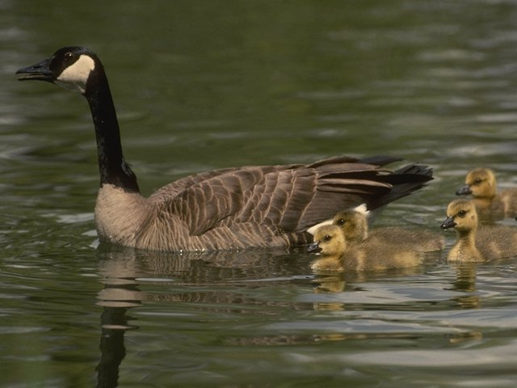
Brighton’s Comprehensive Plan Measure and Evaluate
Complaints
Qualitative site assessments
Nests and eggs
Student research
  Hazing techniques
  Banding
  Telemetry

Slide 20
Brighton’s Comprehensive Plan Monitor numbers
Volunteers
Molt counts
(geese, goslings):
Year 2 – 191, 37
Year 3 – 108, 40
Year 4 – 56, 8
Notes:
Volunteers were encouraged to keep regular counts at problem sites.
Goslings and adults.
Data sheet available.
Will be most important to compare trends in future numbers.

Slide 21
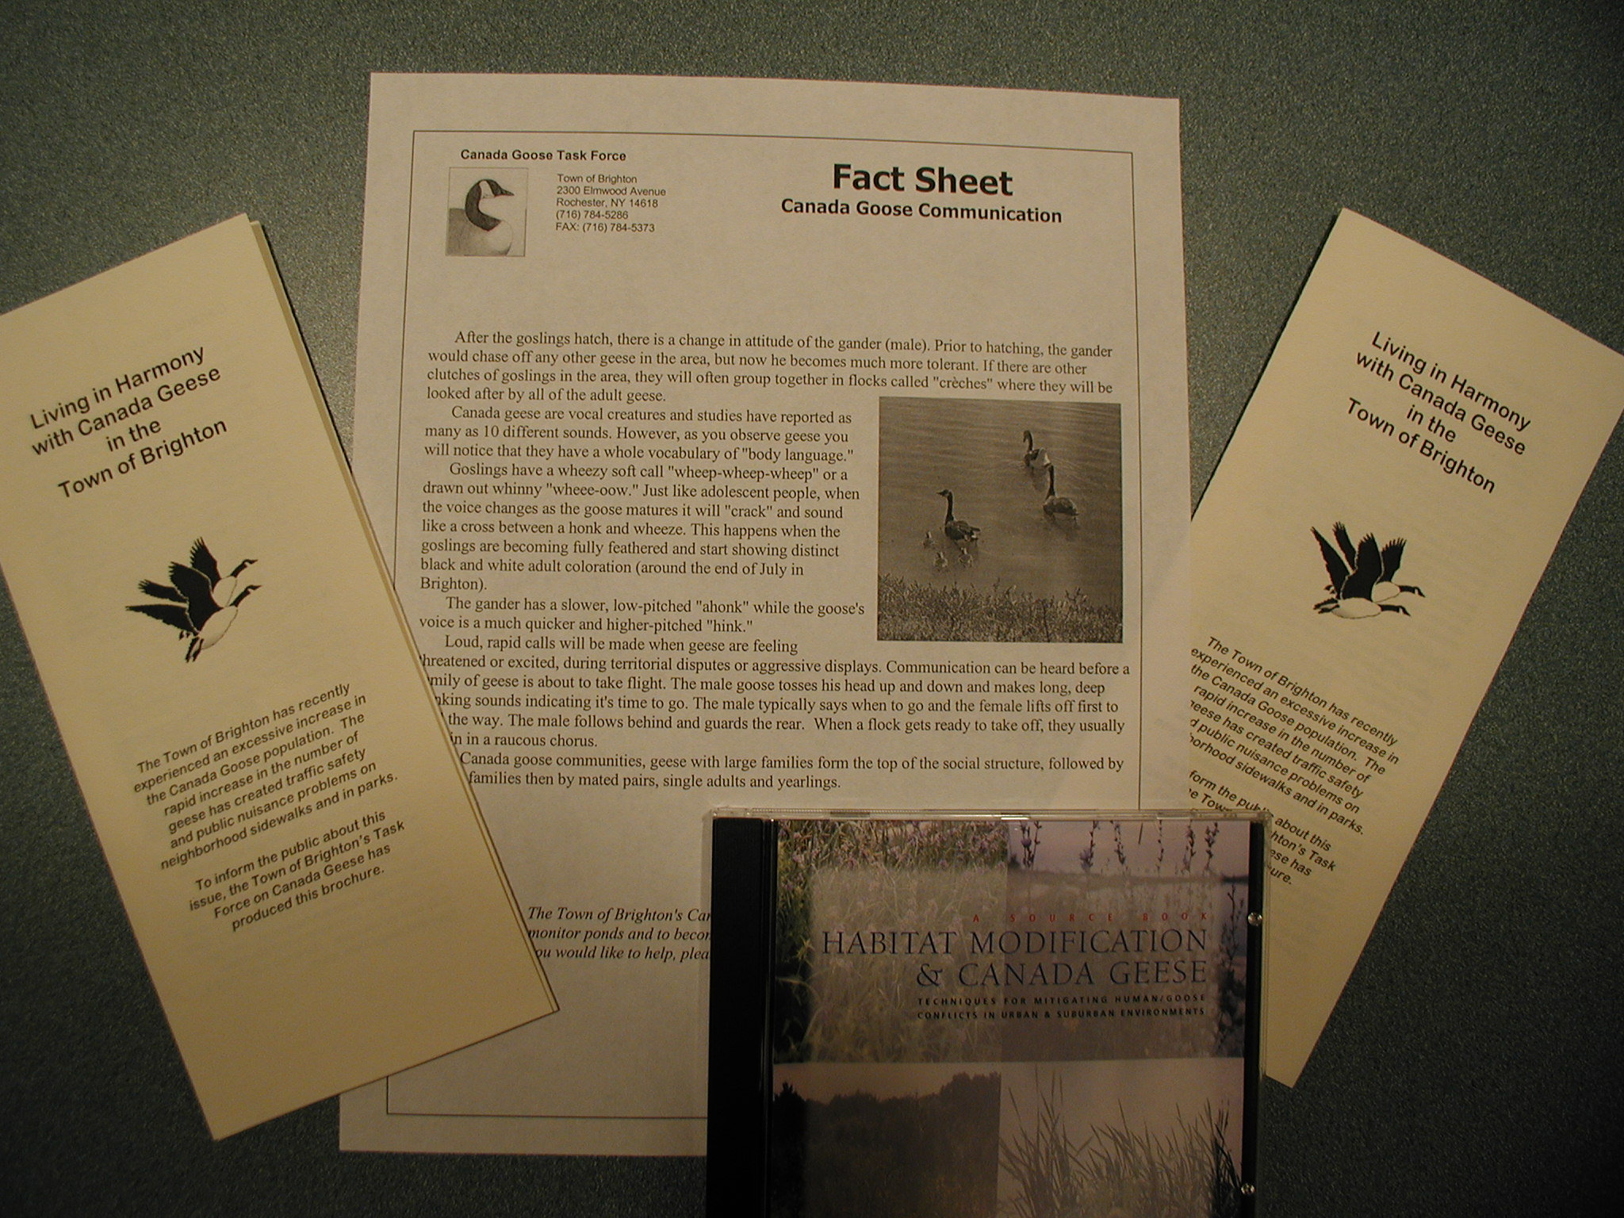
Brighton’s Comprehensive Plan Public outreach
Informational brochure - CD
Fact sheet
Town meetings
Video
Cable access TV
Notes:
Information brochure: “Living in harmony with Canada Geese”
Fact Sheet on goose communication
CD about site development.
Town Fairs
Video produced. Local TV channel. For other towns – described program at Statewide Township meeting .

Slide 22
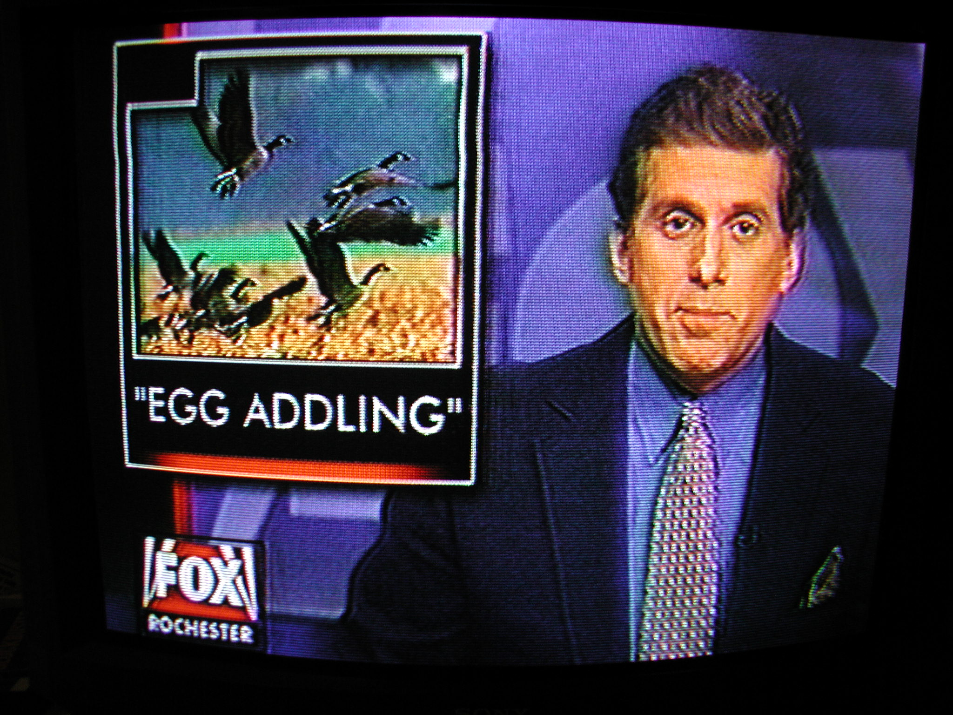
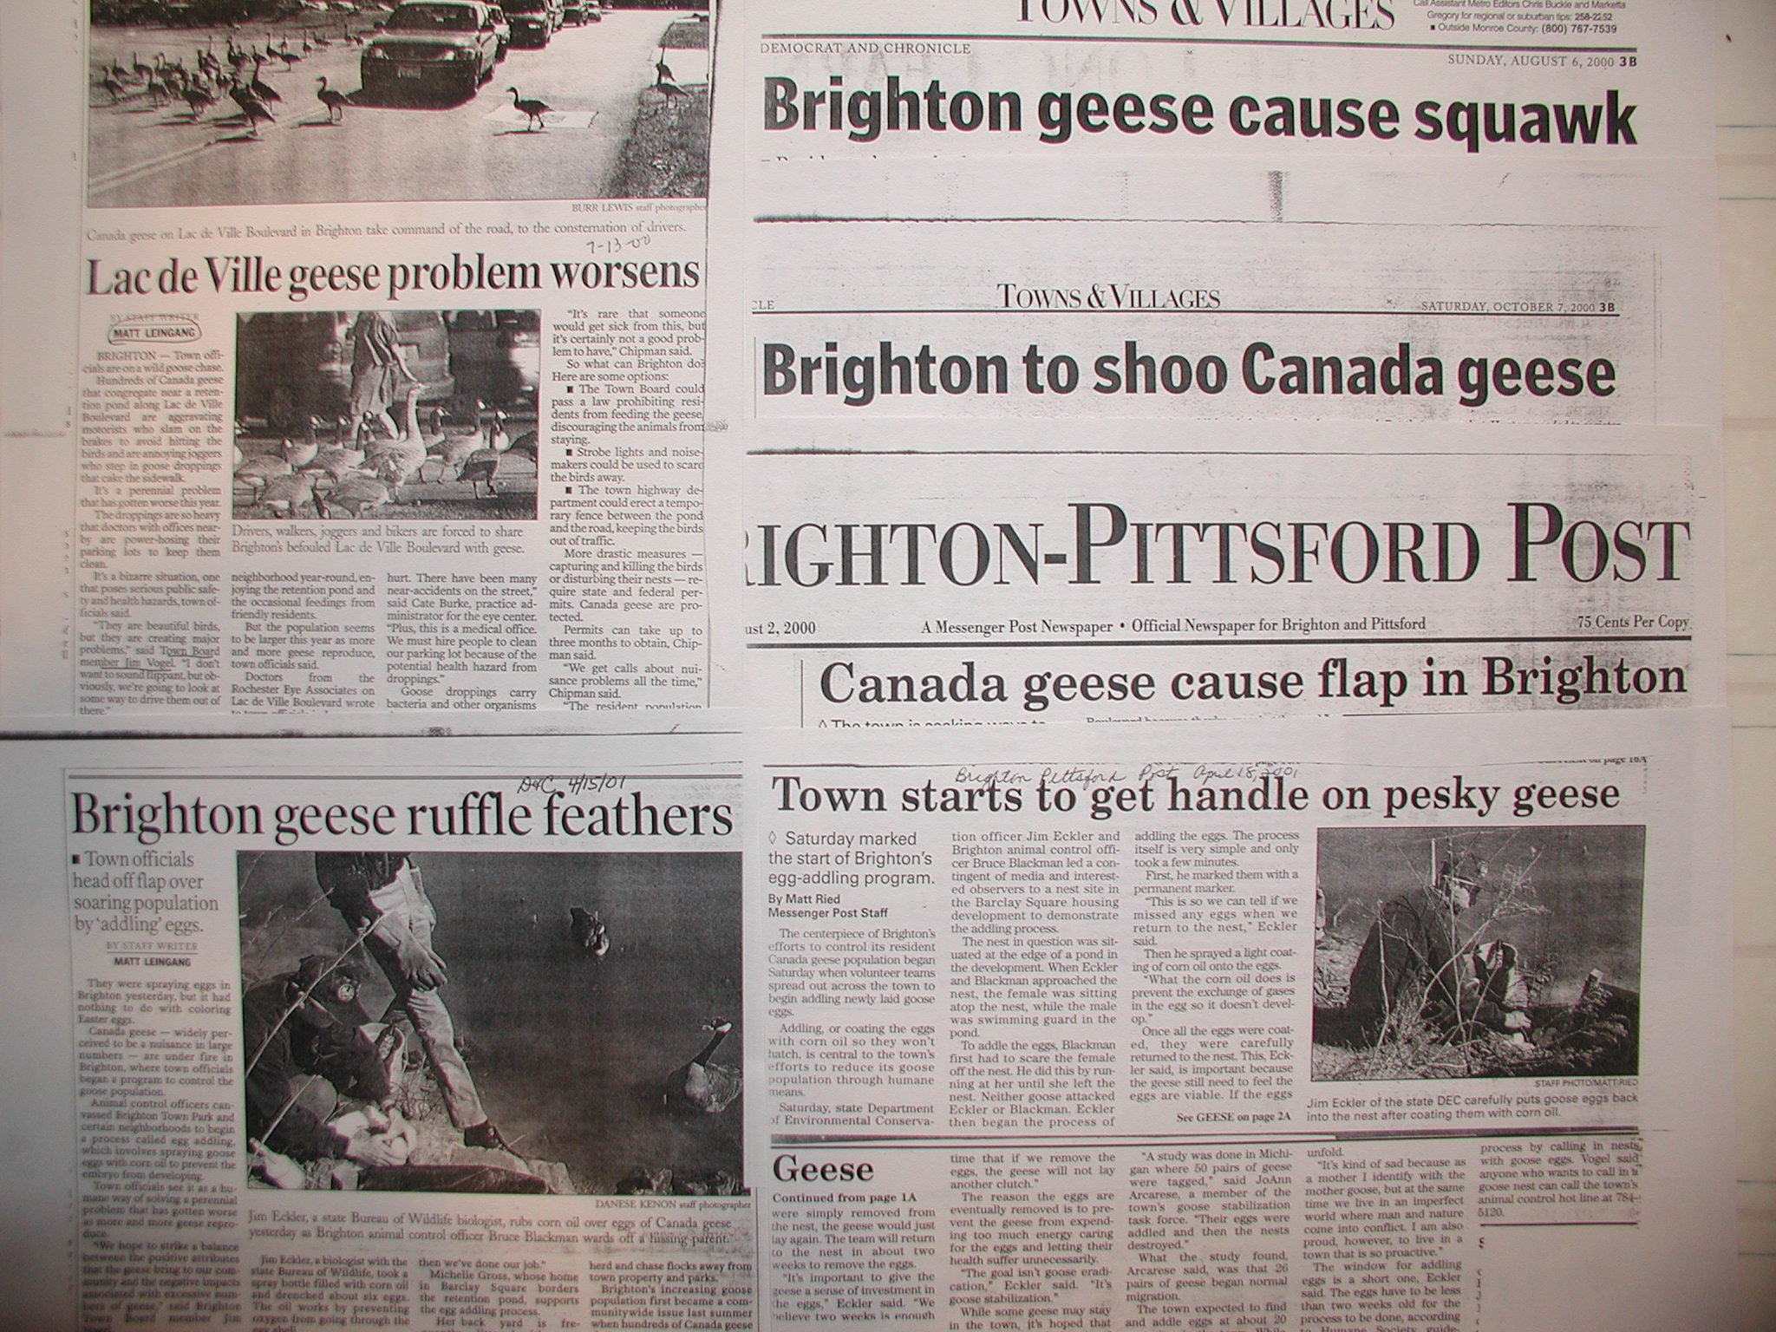
Notes:
Note headlines
newspaper coverage was excellent… and encouraged.
Egg oiling happens around Easter…
We exchanged some exclusive rights to the story for video footage.

Slide 23
Identify the Challenge
Who has a problem and where?
Property ownership
Land use and habitat type
Numbers of adults and goslings
Seasonality
Any public feeding?
Local tolerance for abatement methods, including lethal control
Human resources
Notes:
Important to design the program around problems at specific sites.
Is there a pond?
Mowed grass?
Nesting habitat nearby? (goslings?)
Local tolerance for methods may change… if initial efforts are not effective – introduce new ones. Most likely true for lethal control.
This is something a town or community group can take on.

Slide 24
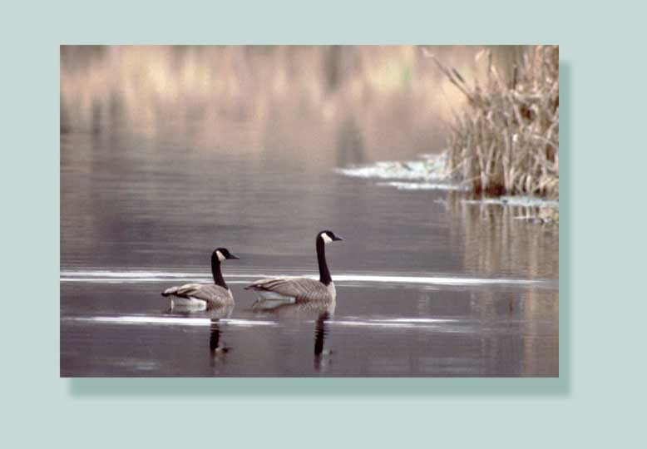
Important
Understand Goose behavior/biology
Apply site specific solutions
Write up a Plan
Involve everyone, Tell everyone, Measure everything
Notes:
Recommendations…
Take home message…..

Slide 25
Thank You
  Jim Eckler
  Wildlife Biologist, NYSDEC
  Northern Montezuma Field Office, Savannah, NY
  james.eckler@dec.ny.gov
  315-365-2134
Connect with us:
Facebook: www.facebook.com/NYSDEC
Twitter: twitter.com/NYSDEC
Flickr: www.flickr.com/photos/nysdec

Slide 26
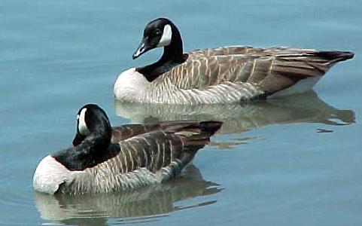
Resident Canada Geese
NY nesters.
2X 1989 to 1998.
Resident geese reproduce at a very high rate.
Notes:
Liberal hunting season in September: 5 bird bag limit (not in Brighton)
Tundra nesters - prefer open areas
Nesting success higher than migrants; nest a year earlier
full molt is Mid-June to late August Can’t fly.
Nest in cattail on muskrat lodge or generally less than 1 mile from water
Goslings and family groups travel 1 to 2 miles along drainages to
brood rearing habitat.

Slide 27
Town Ordinance
§ 40-22 Purpose and intent.
… to preserve the public health and welfare by declaring and enforcing certain regulations and restrictions on the feeding of waterfowl. The Town recognizes that the feeding of waterfowl contributes to the concentration of such birds in areas frequented by the public, that such concentrations are destructive to lawns, can create traffic hazards, and that the resultant quantities of feces create public safety and health concerns on athletic fields, make sidewalks slippery and reduce the aesthetic value of public property.
§ 40-23 Definitions. .
§ 40-24 Feeding prohibited.
It shall be unlawful to provide feed, including, but not limited to, bread, corn and other grains, for waterfowl on public property or on private property without the prior approval of the owner of such property.
§ 40-25 Penalties for offenses.

Slide 28
EGG OILING: Step by Step

Slide 29
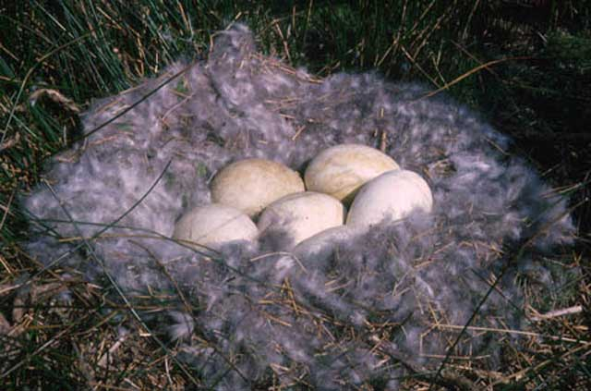
Egg oiling results – Year 2
36 nests
169 eggs
75 hours
No goslings at Lac de Ville
58 goslings informal Town-wide survey
Notes:
29 of 36 nests at 2 sites

Slide 30
Good Question: Are they killing off geese in Webster?
March 14, 2017 06:44 AM
Taney: "The concern is you are going ahead with a plan to kill the geese."
Nesbitt: "That is absolutely not true. We have made no application to the federal government or the NYS Department of Environmental Conservation to do that.“
Taney: “Many residents who are opposed to round-ups claim the town had one back in 2012, did that happen?"
Nesbitt: "Did that happen? Yes it did. It was an experimental program and was done under the watchful eye of the DEC. But again, there are no plans for that this year. I hope by you doing this story, it will put these rumors to rest. We will not be killing any geese."
Notes:
Recently, a nearby town held a meeting to discuss their goose problem.
That meeting lead to Facebook posts claiming the town was looking into a plan to "kill off" the geese. Town hall was bombarded with phone calls from people against the round up.

