Slide 1
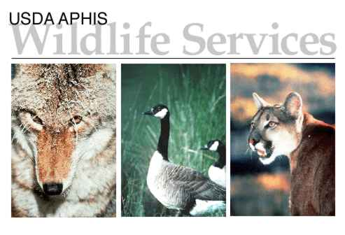
Options for Homeowners and Land Managers in Managing Resident Canada Geese Damage
Carl P. Cranker III
Wildlife Biologist

Slide 2
Wildlife Services:
Our Mission: To provide Federal leadership and expertise to resolve wildlife conflicts and create a balance that allows people and wildlife to coexist peacefully.
We are:
1. Non-regulatory (we don’t enforce laws, just warn you about them)
2. Federal
3. A Cooperative, User Fee Agency
4. Develop Wildlife Management Programs
Notes:
Much of our funding is provided by cooperators. Our niche is human-wildlife conflicts.

Slide 3
Research Based Management Decisions
The National Wildlife Research Center is the research arm of USDA Wildlife Services and is the leader in non-lethal wildlife damage solutions
Approx. 75% of funding spent on non-lethal management tools and methods
Only facility like it worldwide
Socially acceptable WDM methods
Headquarters: Fort Collins, CO
8 Field Stations
Product Registration Unit
The reason we know that egg oiling is 95-100% effective if done properly.

Slide 4
Why are we all here today?
RESIDENT (NON-MIGRATORY) CANADA GOOSE POPULATION IN NEW YORK 1993-2015
Target Population: 85,000
Notes:
NY resident goose population is approx. 3 times NY states goal of 85,000 geese.

Slide 5
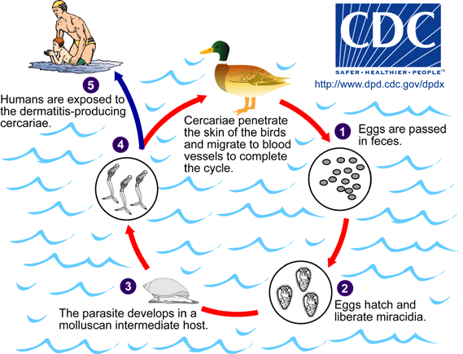
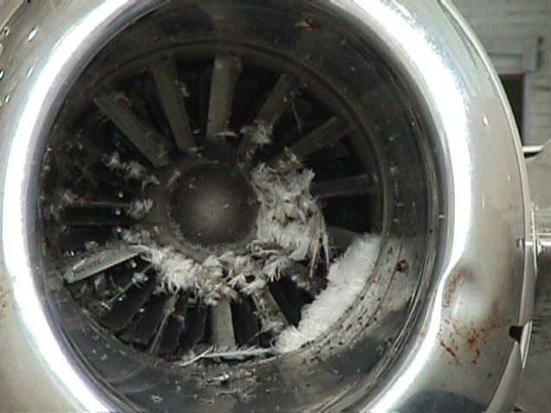
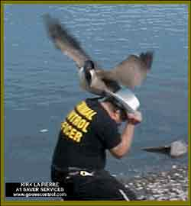
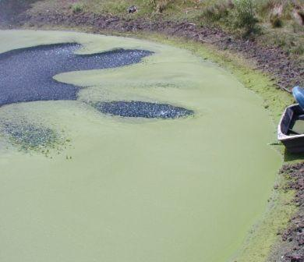
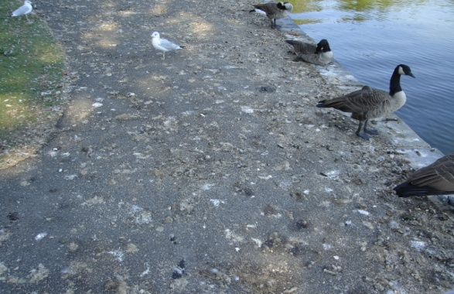
The Damage caused by Geese:
Droppings
Soil Erosion
Noise
Aggressive Geese
Bird Strikes
Crop Damage
Water Quality

Slide 6
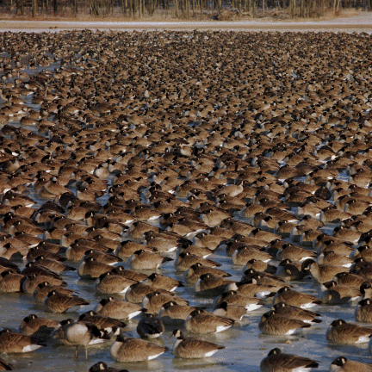

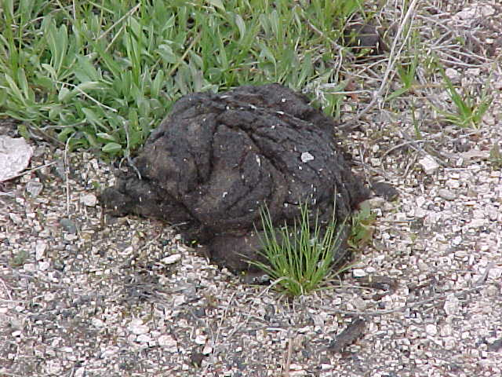
Conflict!
Photos: Visual Media Services, Fermilab
A goose puts out at least 1.5 to almost 2 pounds of manure a day.
(Kear, Janet. 1963. The agricultural importance of wild goose droppings. Wildlife Trust Annual Report 14:72 – 77)

Slide 7
Great Lakes Restoration Initiative: Improving Water Quality within the Watersheds
Notes:
Since 2011, Wildlife Services in NY has received funding through the EPA’s Great Lakes Restoration Initiative to improve water quality in the lake Ontario and Lake Erie watersheds. This is accomplished by capturing and removing geese throughout the watersheds during their annual molting period in June and July. Through this funding Wildlife Service’s in NY has removed around 1000 to 1500 geese each year and reduced the amount of fecal material being deposited it the watershed as shown in the graph.

Slide 8
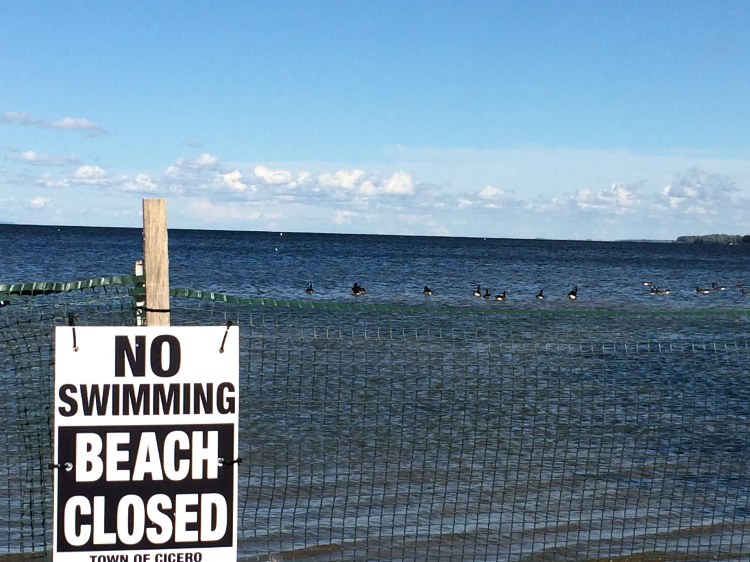
Water Quality Impacts
Goose Fecal Contamination of Water Supply and Swimming Beaches
Goose feces can contain:
Salmonella
E. Coli
Camplyobacter
Cryptosporidium
Notes:
High amounts of fecal material in the water, in particular around beaches, can lead to high bacterial counts and subsequent closures of the beaches. This picture was taken on the south shore of Oneida Lake.

Slide 9
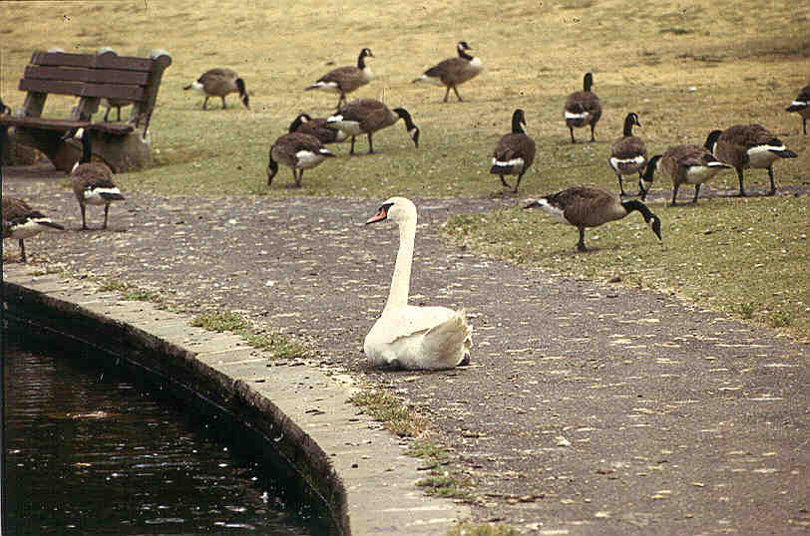
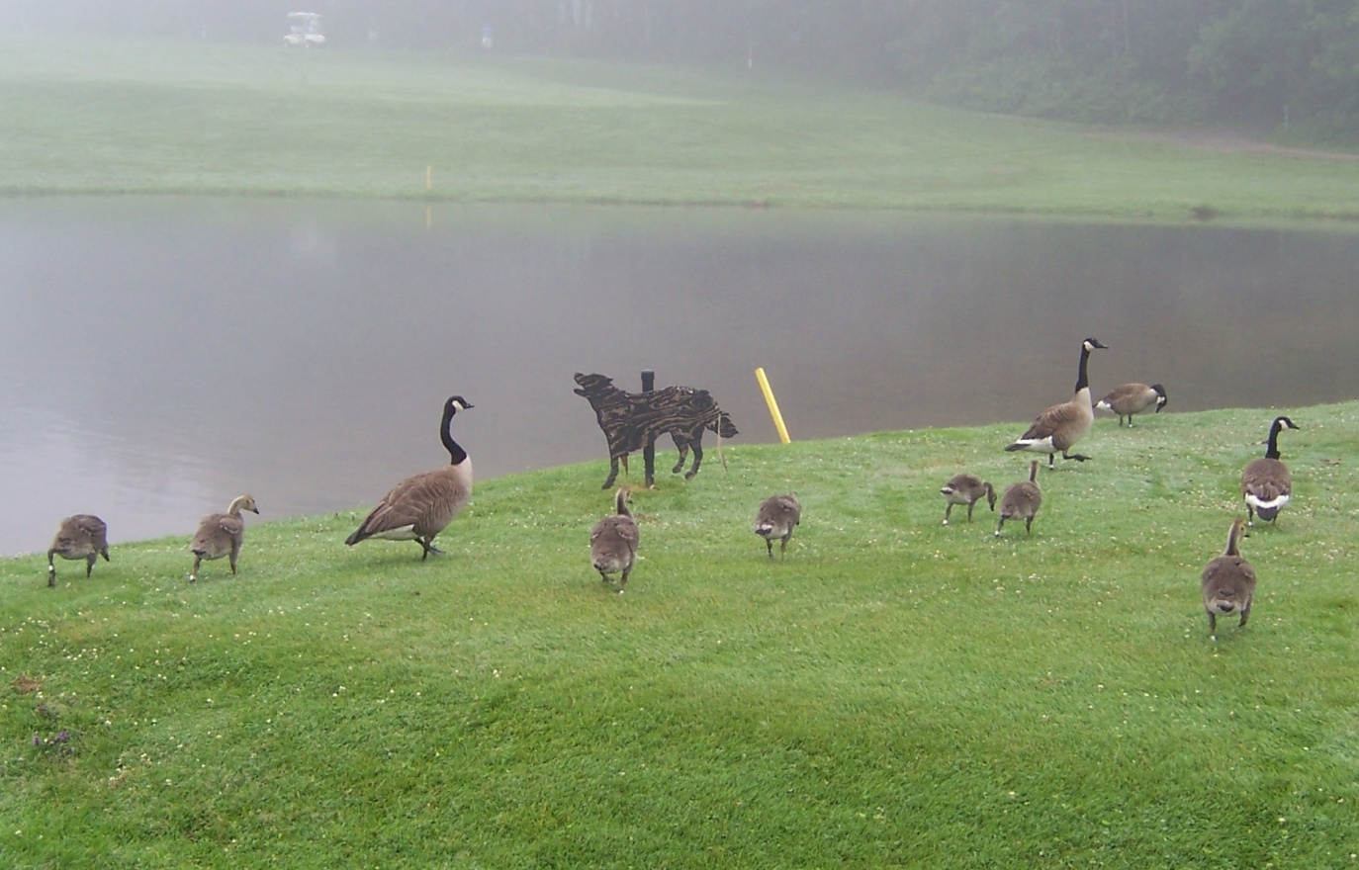
What doesn't work:
Notes:
To lessen the damage we just talked about, I would first like to talk about what does not work.
Mutes Swans are ineffective at displacing geese and are an invasive species and should not be released.
Visual deterrents such dog and coyote silohuettes generally lose there effectiveness quickly. If you do try this method it must be moved at least daily (more often is better) to prevent the geese from habituating to it.

Slide 10
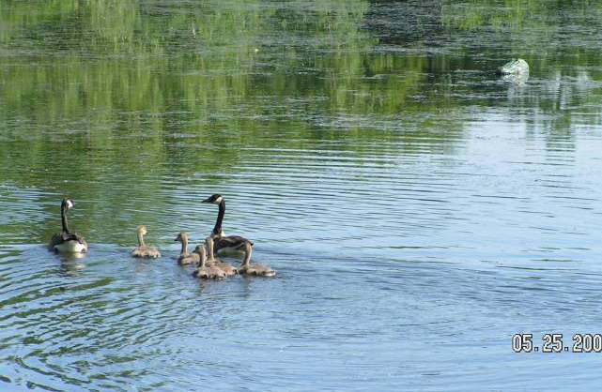
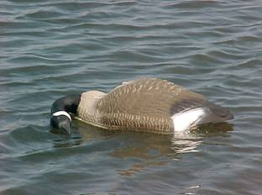
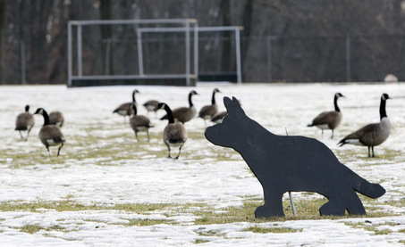
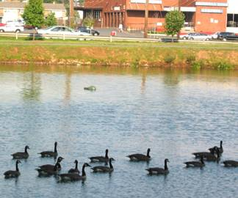
Notes:
A few more examples of ineffective goose management tools, Alligator heads, dead goose decoys, dog silhouette.

Slide 11
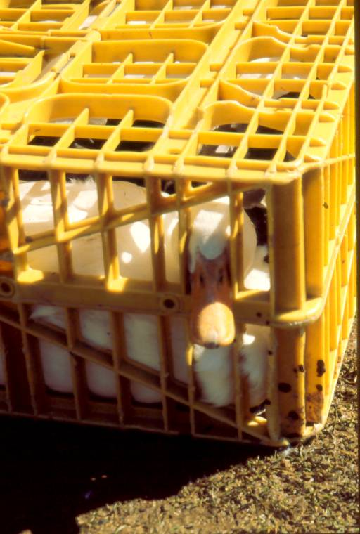
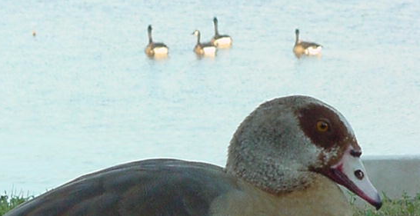
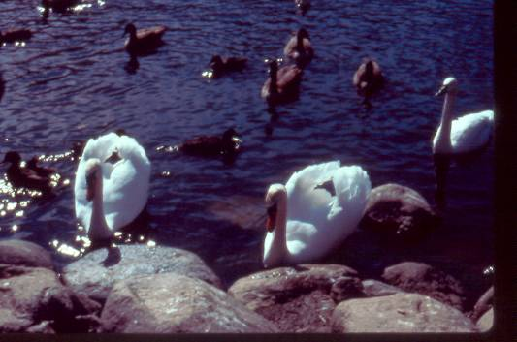
Remove Domestic Waterfowl
Do Not Release Mute Swans
Notes:
Domestic waterfowl should be removed from a site as they serve as decoys for geese and other waterfowl. In addition do no release mute swans as they are ineffective at deterring geese and are an invasive species.

Slide 12
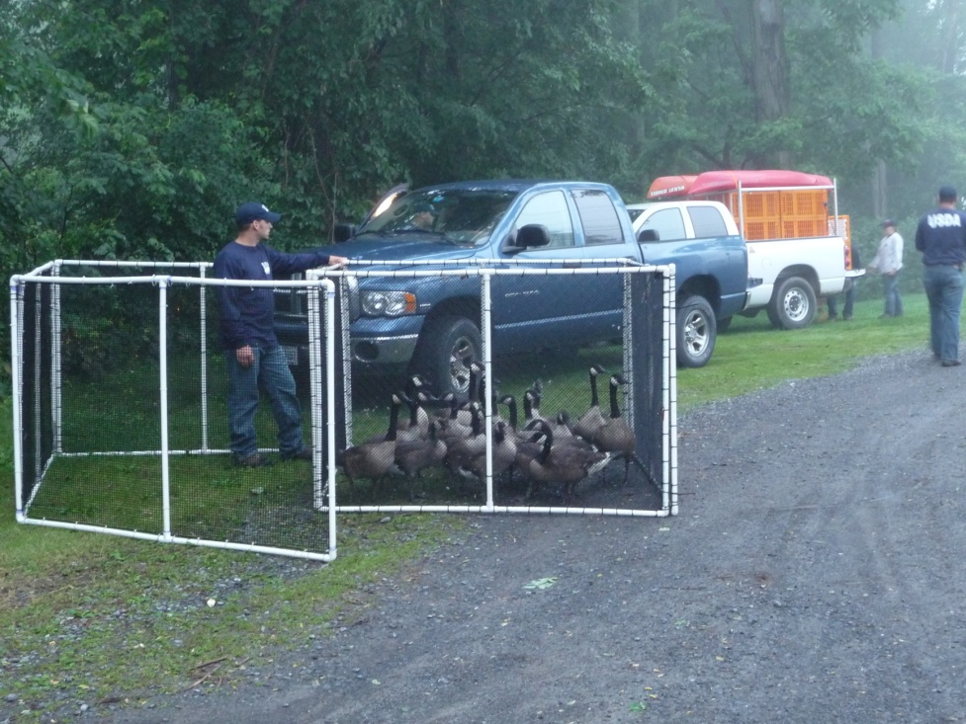
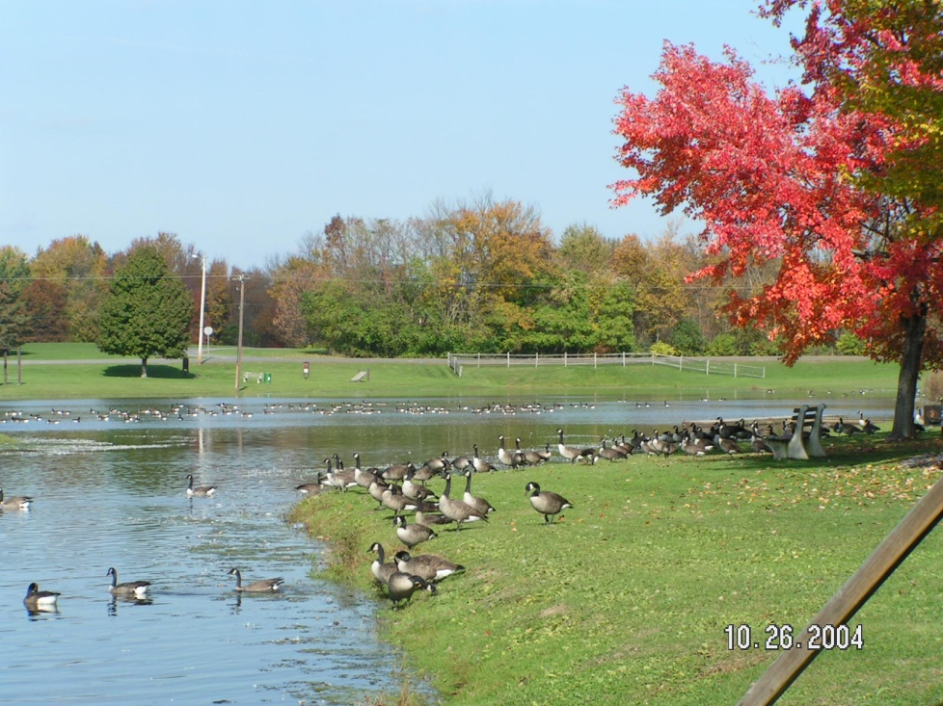
Management Options: Needs to be “community based”
AND accepted by all involved.
1: Educate and involve community
2: No action
3: Nest Treatment (Population Stabilization)
4: Nest Treatment & Pop. Reduction
5: Nest Treatment, Pop. Reduction, & Harassment
Notes:
When addressing a goose issue a community based approach should be taken to achieve the best results. There are four main courses of action that may taken.
No action, the community decides they can live with the geese.
You can chose a nest treatment program to limit population growth.
Nest treatment combined with population reduction, and harassment will be the most effective course of action with the most immediate results.

Slide 13
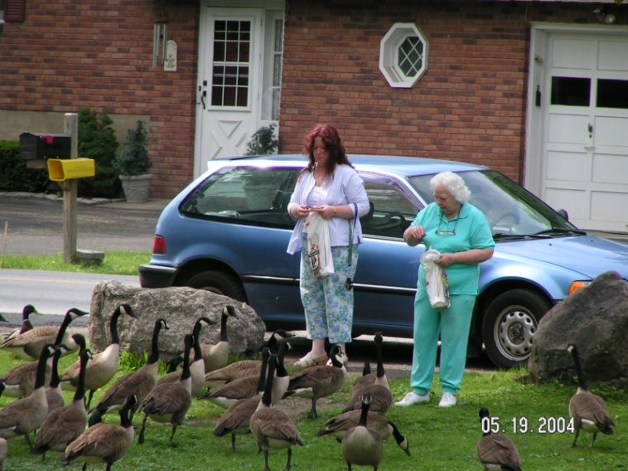
Public Education:
Educate about proper goose nutrition (no bread or popcorn)
Encourage wildlife to remain wild
Feeding creates dependence on human handouts
Feeding increases local populations
Eliminate Supplemental Feeding:
Creates wrong types of fat
Increases local populations

Slide 14
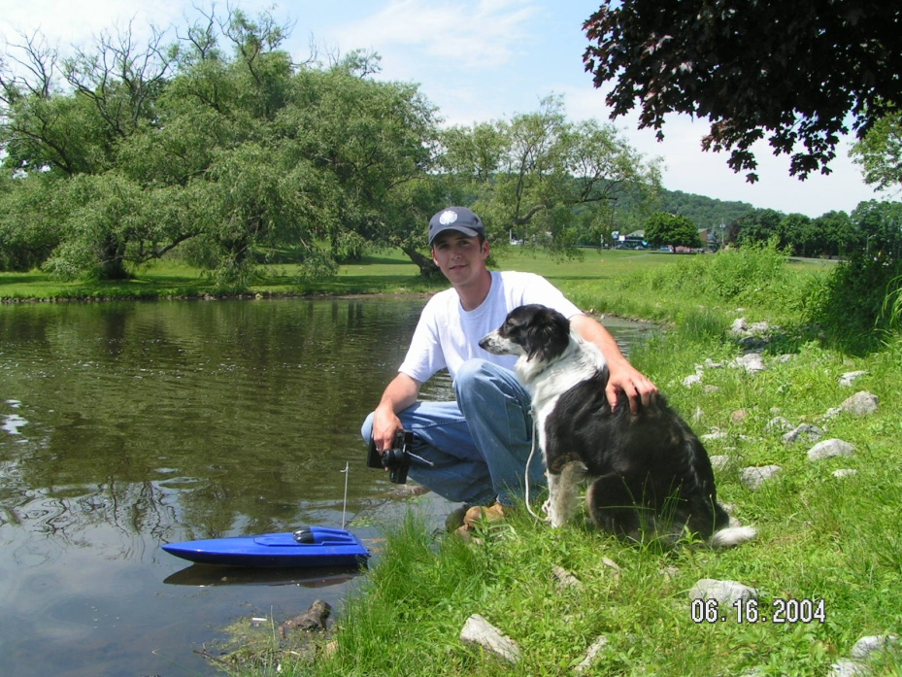
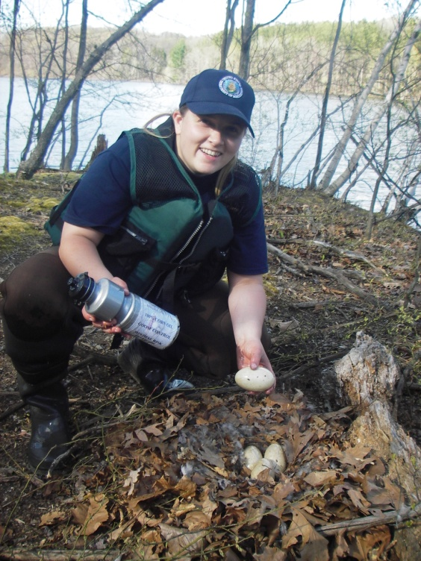
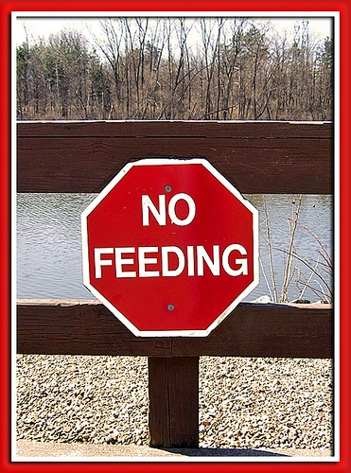
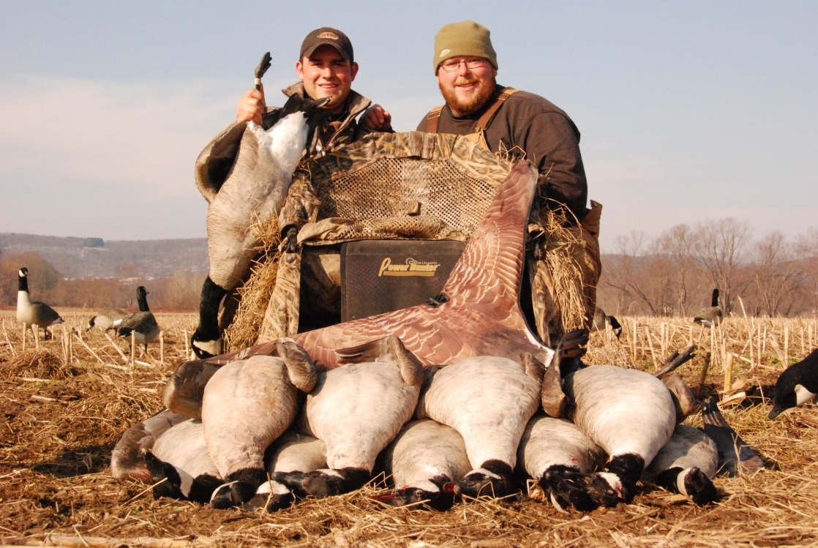
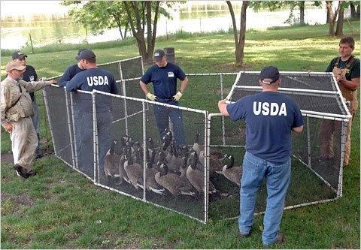
What Works?
Notes:
Nest treatment, which limits population growth.
Eliminate supplemental feeding of geese and other waterfowl.
Population removal of adults during the annual molting period.
Hunter Harvest should always be encouraged at sites where it is a practical approach.
Hazing with trained dogs, pyrotechnics, rc boats can be effective.

Slide 15
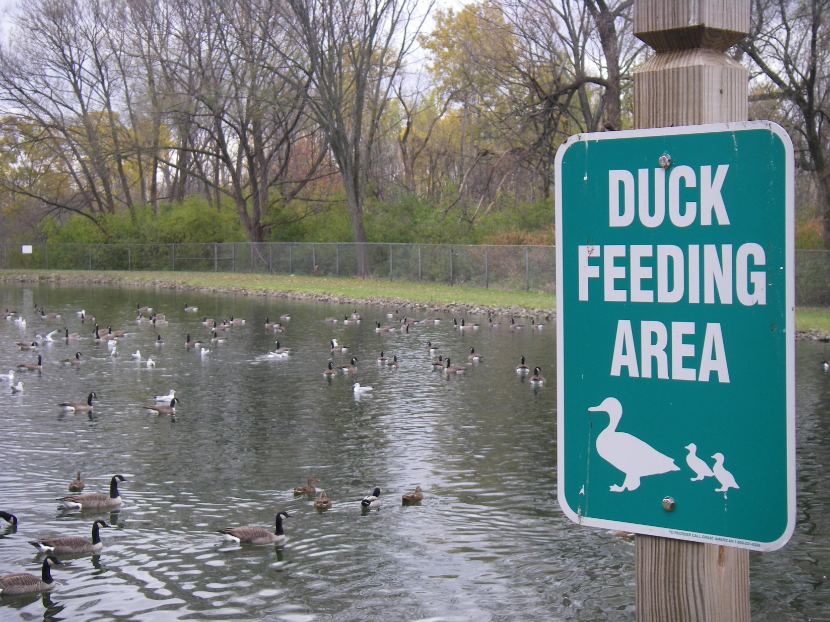
Eliminate supplemental feeding.
Notes:
This was a site in Rome, NY that called about excessive numbers of geese at there property. I offered to come out to the site to assess the situation and make some recommendations to alleviate the damage the geese were causing.
When I arrived this I found this sign encouraging feeding by local residents. By removing this sign and replacing with one discouraging feed and educating the public about why the geese should fed the geese dispersed and the damage improved immensely.

Slide 16
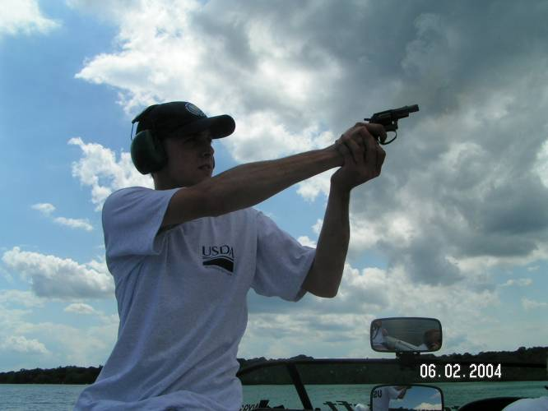
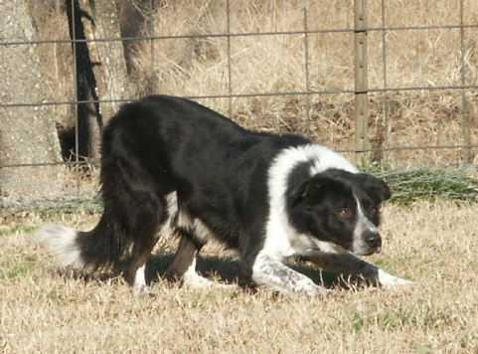
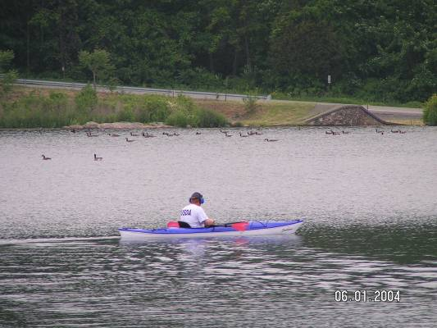

Hazing Techniques
Pyrotechnics
Dog Chase
R/C Boat Chase
Boat Chase
Laser (night)
Notes:
These are the main tools in any hazing program to discourage the use of a site by geese.
Pyrotechnics are one the most effective tools and I will talk in more depth about them on the next slide.
Using properly trained dogs can be effective part of a program. The disadvantages with dogs are they can be expensive to purchase and or hired as part of a goose management program.
RC boat are effective provided the water is not to weedy and are relatively inexpensive to purchase.
Boat chases with kayak can help to move geese off of a site.
Laser can be useful at night to haze geese that are at the site. They are expensive to purchase.

Slide 17
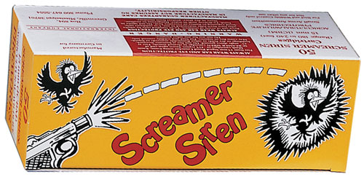

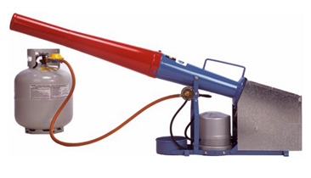
Pyrotechnics:
Advantages:
Loud – startles birds
Affordable
Easy to use
Disadvantages:
Scares people too!
Can be dangerous if improperly used
Potential fire hazard

Slide 18
Pyrotechnics:
Advantages:
Loud – startles birds
Affordable
Easy to use
Disadvantages:
Scares people too!
Can be dangerous if improperly used
Potential fire hazard

Slide 19
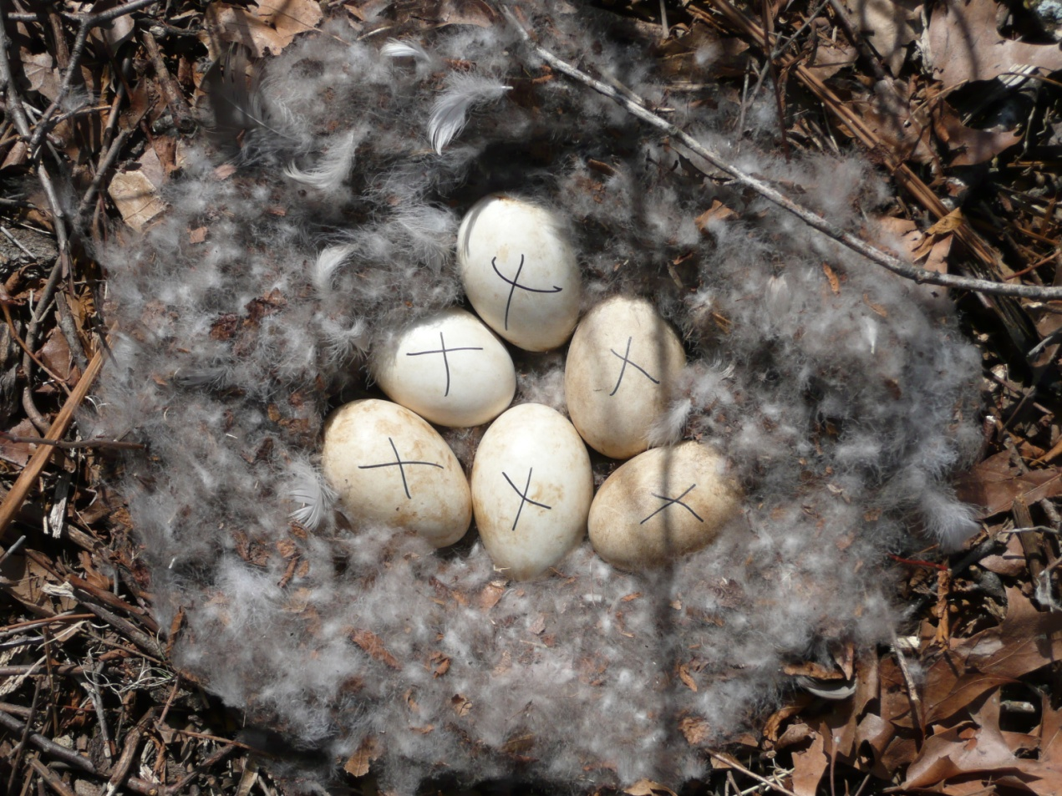
Nest Treatment Options
Canada Goose Nest Management
DIY: Do It Yourself
Apply for a free online permit that allows you to oil/puncture/shake eggs on privately owned property.
https://www.epermits.fws.gov/eRCGR/
Hire an outside agency or company to do the work.
OR
Notes:
There are two main routes to take when conducting nest management, you can do the work yourself or hire an outside agency or company to do the work.
A permit needs to be obtained for the property through the USFWS. This can be done online at epermits.fws.

Slide 20
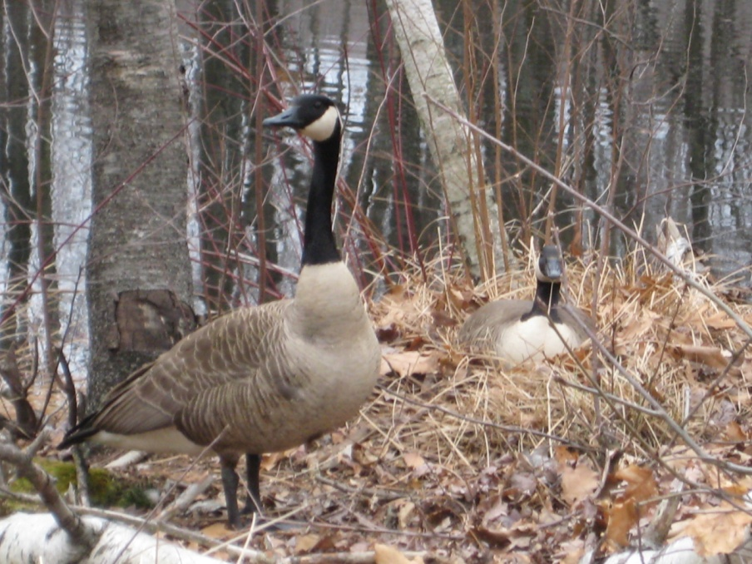
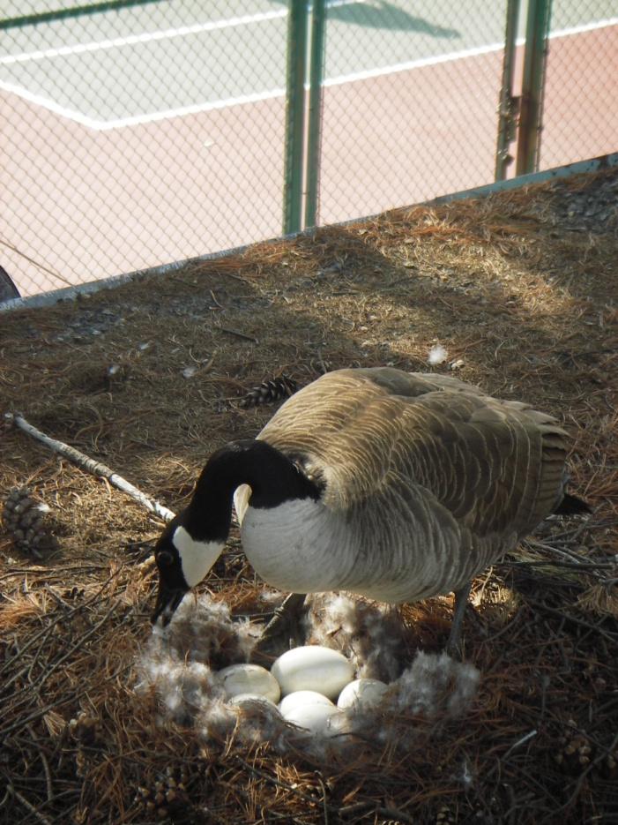
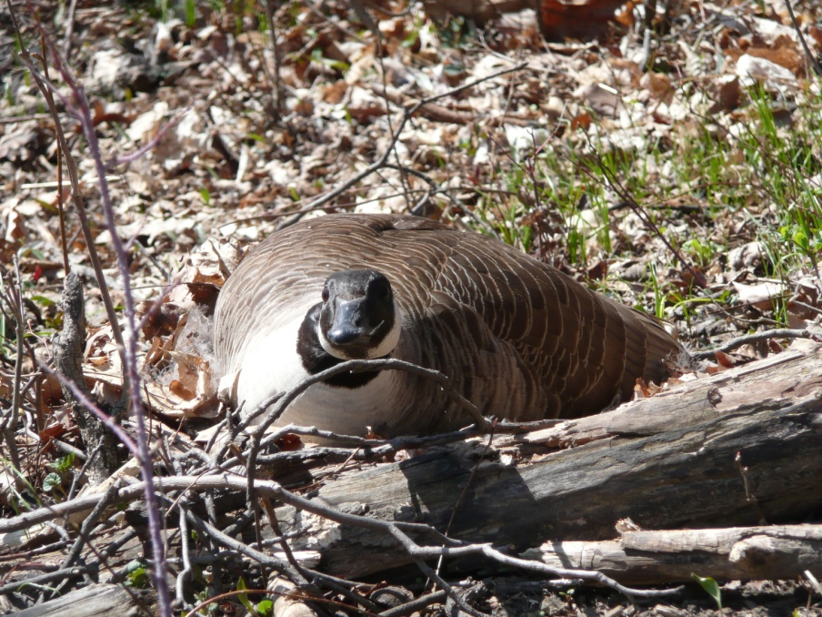
Where do geese nest??
Canada Goose Nest Management
On the Ground
Islands
Peninsulas
Shoreline
Rooftops
Up to 2 miles
from water.

Slide 21
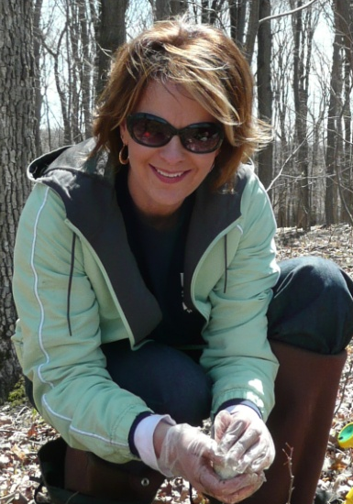
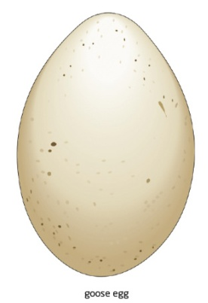
Population Stabilization – Nest Treatment
Egg oiling
The oil seals microscopic pores in the eggshell, preventing gas exchange, and further development.
Goose remains on nest
Fewer nest predators
Has to be repeated
* Method also endorsed by the HSUS and PETA
Notes:
The preferred method to treat goose eggs to prevent them from hatching is to use 100% corn oil to coat the eggs.
This prevents gas exchange and stops the egg from developing.
Oiling should be repeated 2-3 times throughout the nesting season for the best results.
The reason for oiling the eggs and not just removing them is the could re-nest in a different location and you may or may not be able to find the nest again.

Slide 22
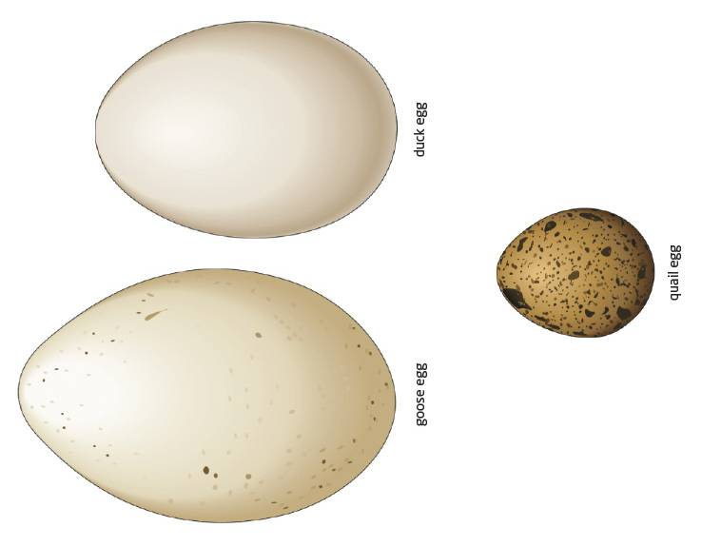
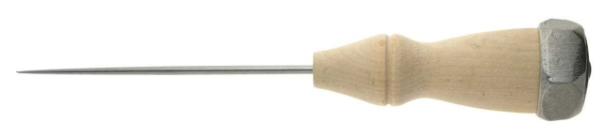
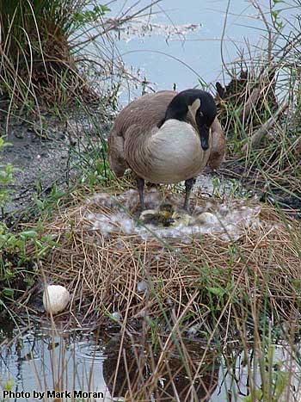
Population Stabilization
Puncturing
Eggs
“Scrambles” embryo
One time application (if timed right)
May entice nest predators
More difficult to do correctly
Notes:
Another method to treat goose eggs is to puncture the egg.
Disadvantages of this method is the eggs integrity is compromised and the goose may break them when re-entering the nest .
In addition the hole leaves more scent and may attract predators that will destroy the nest, potentially causing the goose to re-nest in a different location.

Slide 23
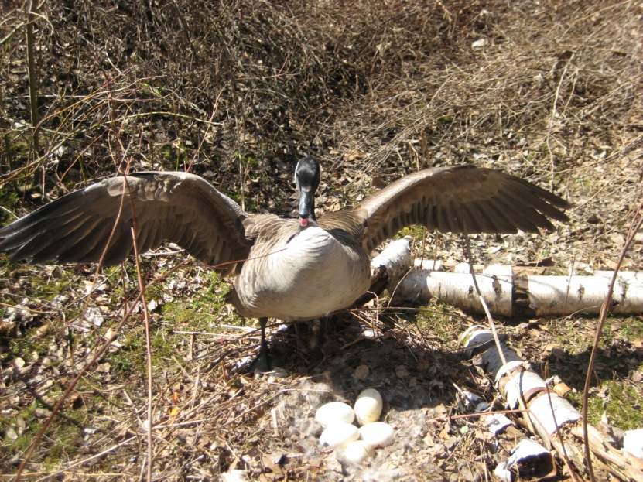
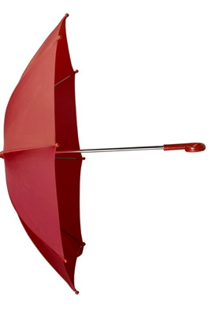

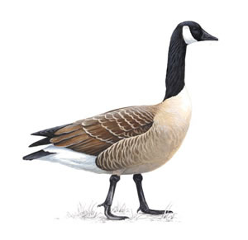
Safely Interacting with Geese
Notes:
Geese can be quite aggressive in defending the nest.
Nest treatment should be conducted with 2 people. One person to distract the goose while the other person treats the nest.
A cheap umbrella works as good tool to keep the goose at safe distance.

Slide 24
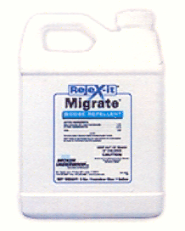
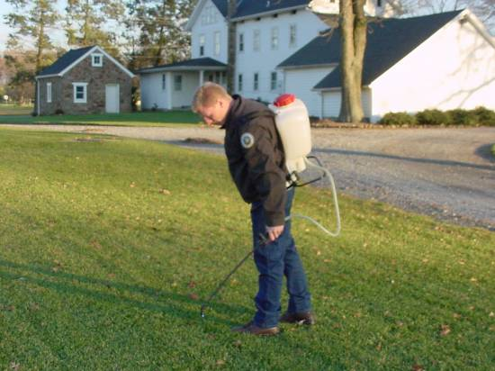
Chemical Deterrents:
REJEX-IT Migrate
General use pesticide: Private property owners
and businesses do not need to be certified
pesticide applicators.
Methyl Anthranilate (Taste Aversion)
Cost per acre (1 treatment) = $130 (2.5 gallons)
Application may last 2-3 weeks

Slide 25
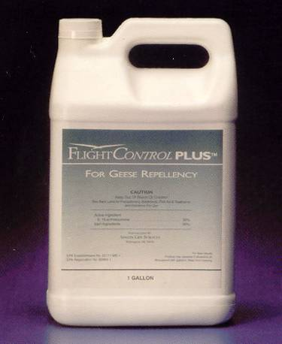
SEPRO Flight Control Plus (Geese)
Restricted use pesticide
3A (Turf) or 3B certification
Anti-feeding (digestive irritation) &
visual warning
Cost per acre = Appx. $200 (1 gallon)
Application may last a
few weeks

Slide 26
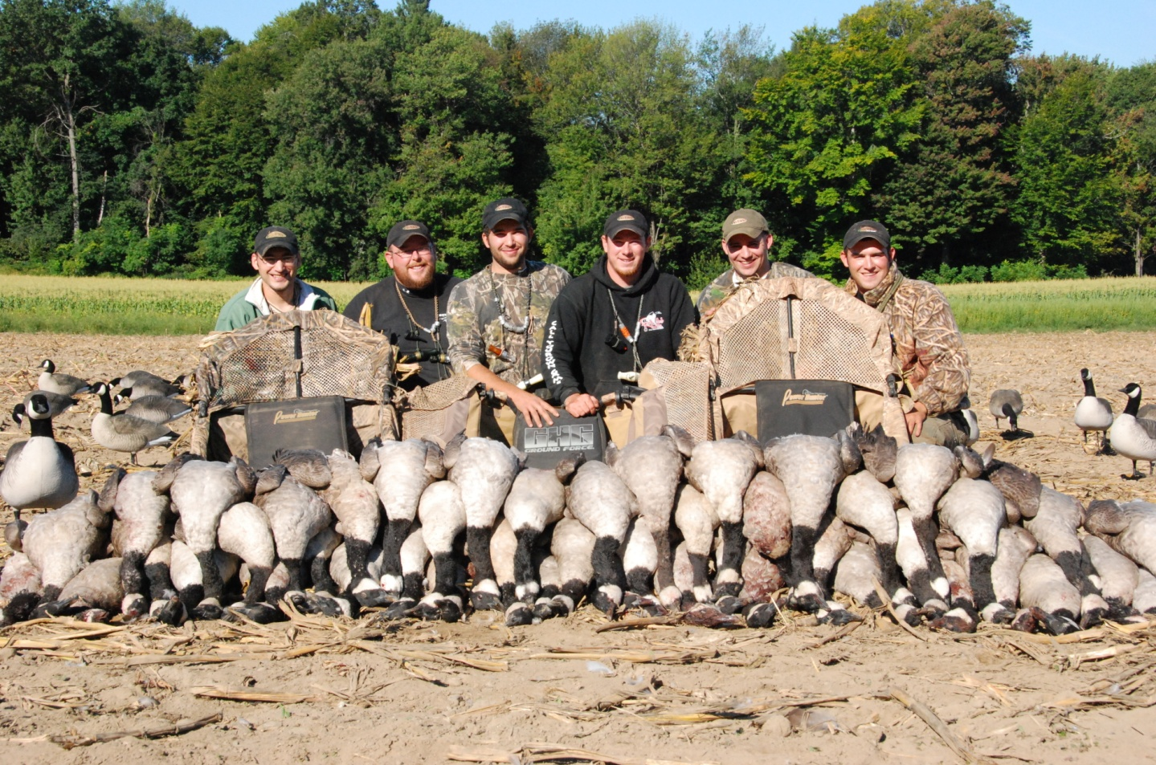
Legal Harvest
Licenses needed:
  Small game
  Waterfowl Stamp
  HIP number
Liberal hunting seasons have been in place since 1990 for resident Canada geese in NY.
8/15 goose per day limit in September
Notes:
Legal Harvest should always be encouraged at sites where it is feasible.

Slide 27
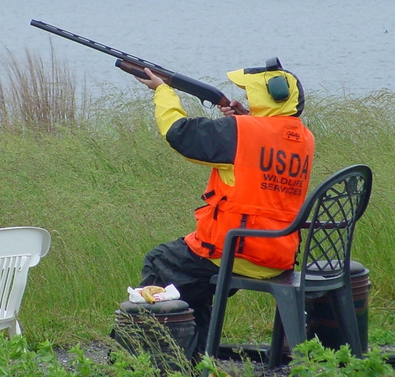
Using the Depredation Permit to Reinforce Non-lethal techniques
Migratory Bird Depredation Permit
$50 and up to 2-3 month process
Safety First!
Must be 500 ft away from houses and clear beyond target.
Notes:
Is not a primary means of population reduction, is intended to reinforce non-lethal techniques to keep geese from habituating to the non-lethal methods be used.

Slide 28
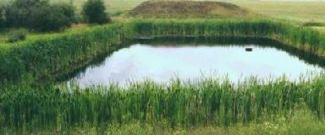

Habitat Management:
Tall Grass Management
Fencing around pond
Grid wires
Planting trees
Disadvantages:
Incompatible land use
Geese may make paths
Fencing unattractive
Grid wires need adjusting
Not this guy!

Slide 29


Exclusion
Placement of a barrier between Canada geese and the resource needing protection.
Temporary or permanent
Works during molt.
Notes:
Exclusion can be useful particularly during the molt when geese cannot fly. They can be temporary as shown in the photo with the dock or a more permanent structure.

Slide 30

Population Reduction:
Capture and Removals
  Geese are captured during the “molt” when they are flightless in June/July.
  Geese are crated and transported to a licensed poultry processor.
  Processed goose meat is then donated to a local food bank.

Slide 31

Population Reduction:
Notes:
Leads of snow fence are used to guide the Geese into a temporary corral that is closed behind then. They are then crated and transported to a processor and the meat is donated to local food banks.
Capturing geese during the molt is the most effective method of population reduction in both terms of effectiveness and cost.
Most capture and removals take less than one hour on site and in may instances can be quicker than that.

Slide 32
Removals over time reduce numbers significantly
Notes:
Here is some data from Rikers Island, NY in which geese capture and removed during the molt for several years and the subsequent reduction in goose numbers at the location.

Slide 33


Water Quality Impacts
The Need for Community Involvement
Salmonella
E. Coli
Camplyobacter
Cryptosporidium
David C. Webb Memorial Park at Taft Bay.
Notes:
This is an example of one of the needs for community involvement. A group of geese on the north shore on Oneida lake was causing damage at Webb memorial park at taft bay. We attempted to capture the geese at the park, however the geese were not present at the park when we showed up to conduct the management.
On large bodies of water having multiple sites to capture the geese is necessary to successfully capture them.

Slide 34
The Big Picture:
There is an estimated 78,872 breeding pairs of Canada geese in New York alone. Which could equate to roughly 60,000 nests this spring.
In New York, if there was a 5 egg/nest average, just to stabilize the population, combined we would have to oil 300,000 eggs this spring.
Capture and removal of geese is estimated to cost 67% less then egg removal or destruction (Cooper and Keefe 1997).
Egg oiling works in localized areas over time, but has very little effect on the overall population of geese, while removing breeding age adults can lower populations dramatically.

Slide 35
What The USDA can do for you:
Provide “Technical Assistance”: Either over the phone or as a site visit to advise how to manage your situation.
Provide direct management where we would form an agreement and conduct:
      Nest Management Program
      Hazing Program
      Population Reduction (Capture and Removal)

Slide 36

Contact Information:
Questions??
Carl P. Cranker III Wildlife Biologist
USDA Wildlife Services
5757 Sneller Rd
Brewerton, NY 13029
315-698-0940

