Slide 1
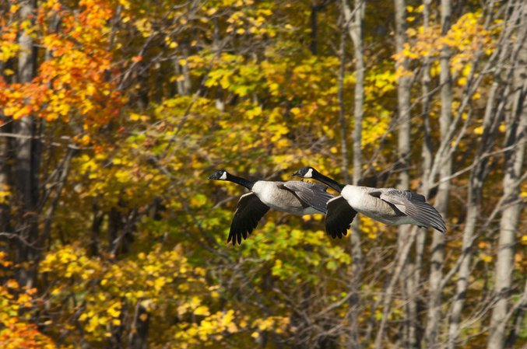
Canada Goose Management in New York State

Slide 2
Levels of Management
Federal:
    Protected by the Migratory Bird Treaty Act
    Responsible agency – United States Fish and Wildlife Service
State:
    Protected migratory game bird

Slide 3
Populations
Three populations found in New York:
      Migratory –
        Atlantic Population (upstate)
        North Atlantic Population (Long Island)
      Resident “non-migratory” –
        Atlantic Flyway Resident Population (statewide)

Slide 4
Notes:
Breed in northern Canada between the Hudson and Ungava bays.
Migrate late October down through NY and are here (or points south) through late March.

Slide 5
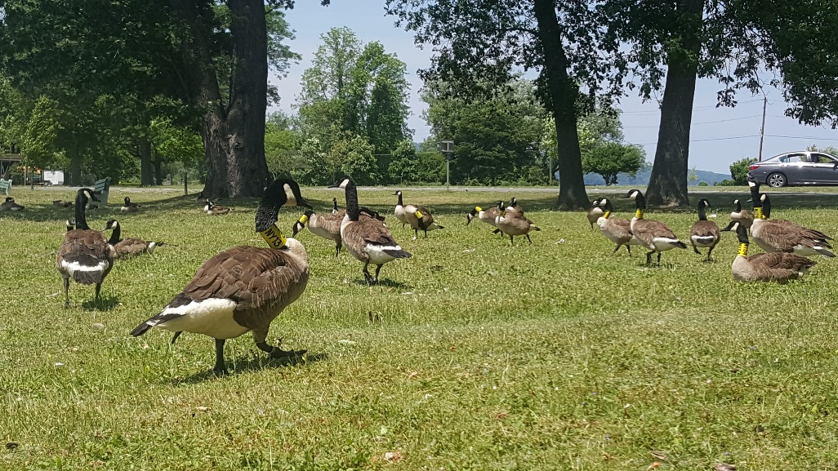
Notes:
Breed throughout the Atlantic Flyway. Short distance migrant. Molt migrate (into lower Ontario). Will migrate short distances (up to a few hundred miles) in the winter.

Slide 6
Population Objectives
Atlantic Population
- Atlantic Flyway Management: 225,000 breeding pairs
Atlantic Flyway Resident Population
- Atlantic Flyway: 700,000 total birds (spring), by 2020
                1.4 geese per square mile
- New York: 85,000 total birds (spring)
          1.8 geese per square mile

Slide 7
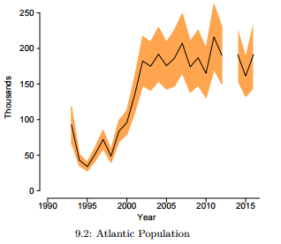
Where are we now?
Atlantic Population:
  A true success story in wildlife management
  Atlantic Population breeding pairs bottomed out at just 29,000 birds in 1995
  2016 estimate: 190,000 pairs
Notes:
Breeding Canada geese in New York

Slide 8
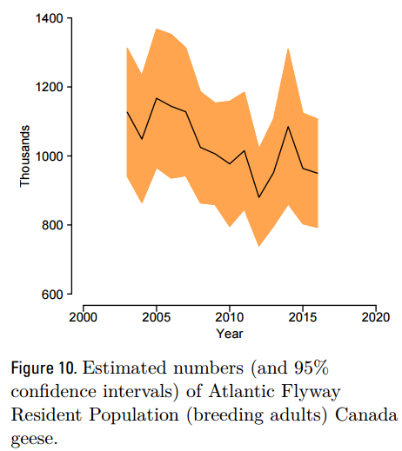
Where are we now?
Atlantic Flyway Resident Population:
  Too much of a good thing?
  Stable population since 2003, no significant trend
  2016 estimate: 950,000 total birds

Slide 9
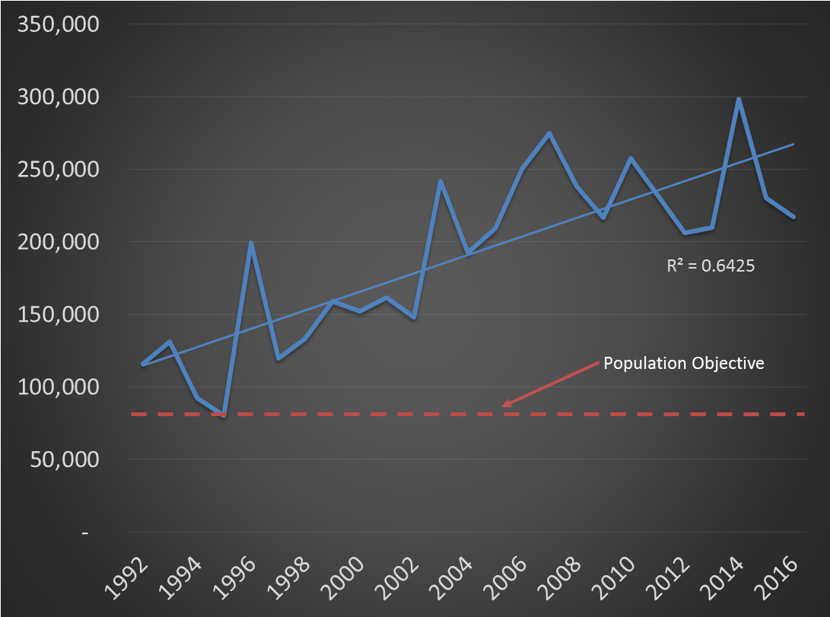
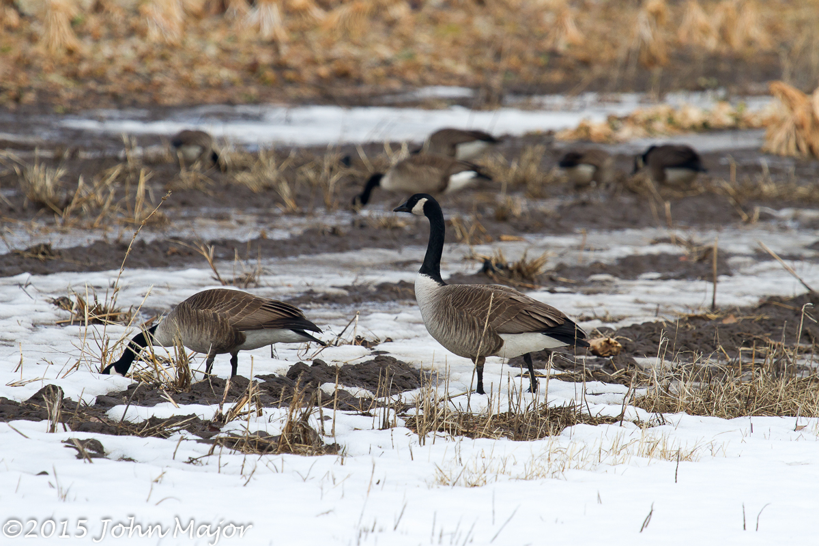
Resident Goose Population Status in New York

Slide 10
Management options - the toolbox
Hazing – no permit required
Egg addling/nest destruction
-registration required (USFWS)
Regulated hunting
Federal Depredation Order
– requires “Record of Authorization” from DEC
USFWS Depredation Permit
Notes:
No federal or state permits are needed to scare, herd, or chase away geese by any means, including dogs or noisemakers, as long as no birds are physically harmed.
Egg addling – requires registration (https://epermits.fws.gov/eRCGR/) annually and reporting – no state permit or registration

Slide 11
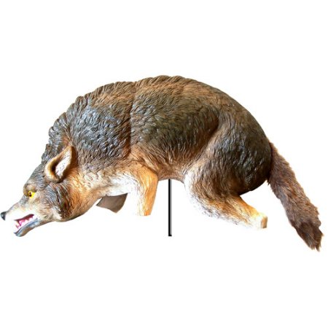
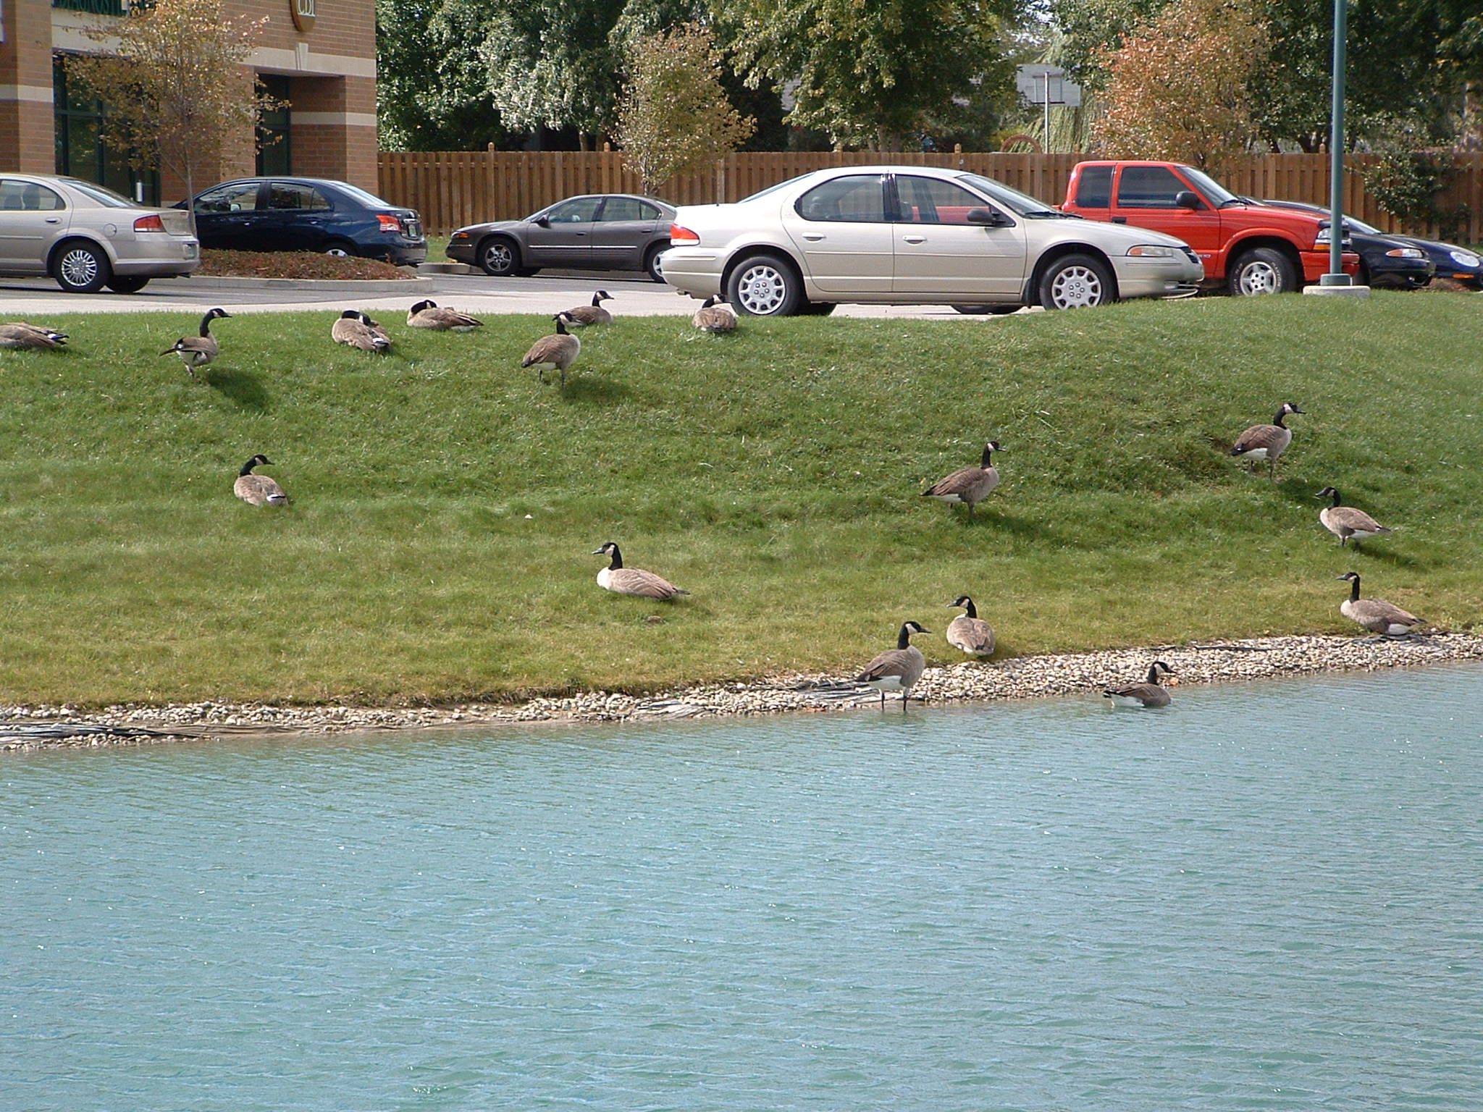
Other non-lethal management tools
Prohibit feeding
Habitat modification
Fencing
Grid wire
Visual deterrents
Chemical deterrents

Slide 12
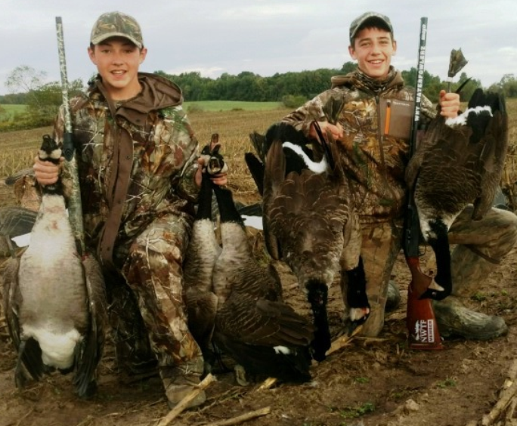
Hunting
  Primary management tool
  Special seasons in some zones:
    25-day September season
    liberal bag limits (8-15/day)
    special hunting methods allowed
Regular season
  Between 30-60 days
  Restrictive bag limits (2-3/day)
  Between late October-January
Notes:
Special seasons designed to target resident Canada geese. Seasons must end by Sept. 25th in NY because research shows that is when the first migratory birds begin to show up.

Slide 13
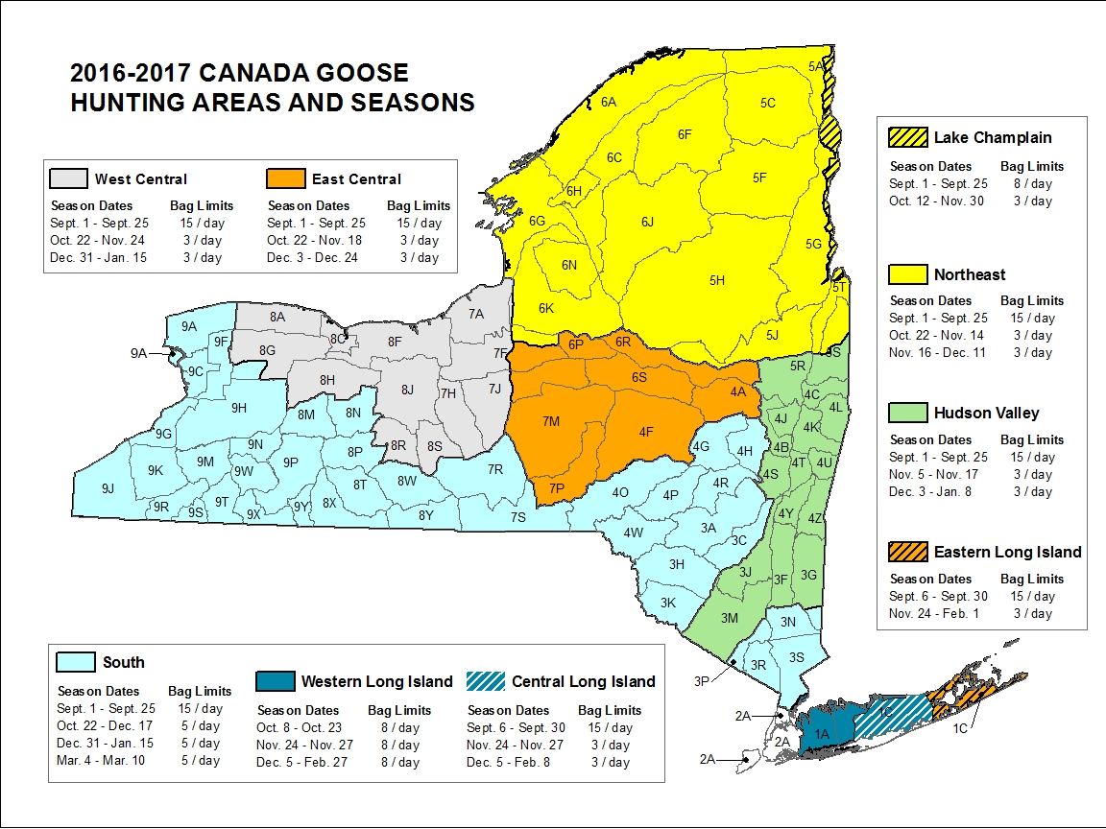

Slide 14
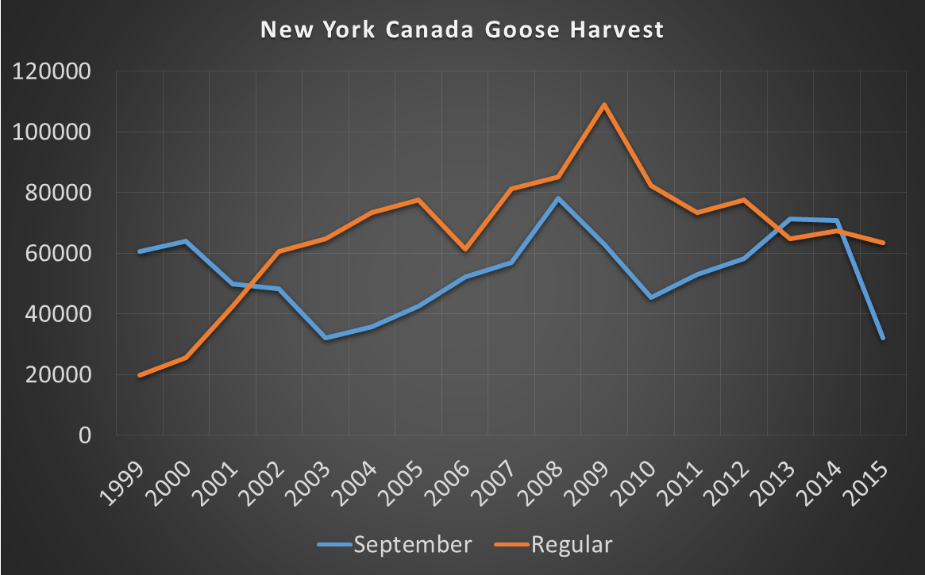

Slide 15
Management begins with the landowner!
The landowner is the one experiencing the damage
Management tools are available to address the localized, short-term, impacts
But what about long-term?

Slide 16
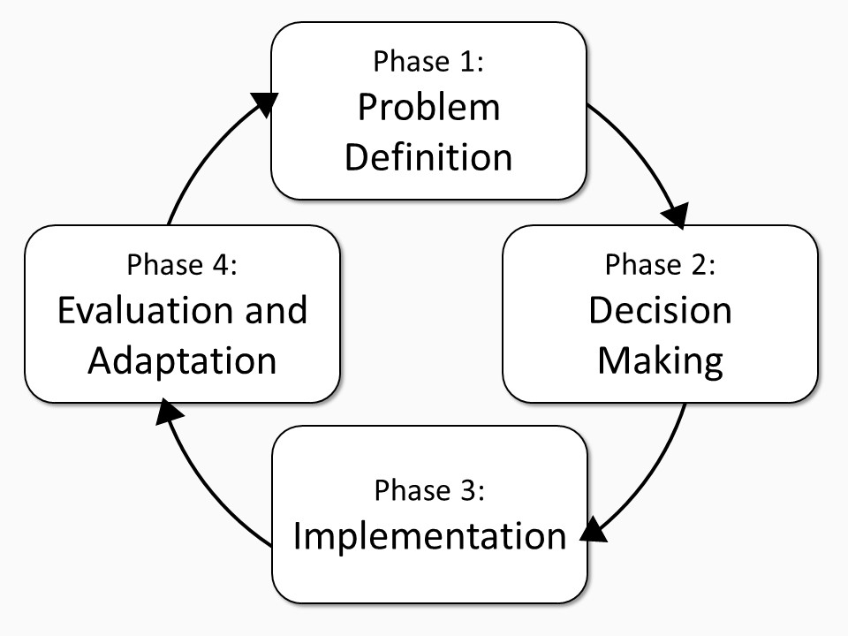
Community-based nuisance wildlife management
Necessary for long-term success
Cornell University

Slide 17
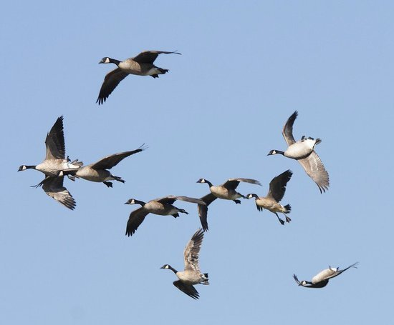
Questions?

Slide 18
Thank You
  Joshua Stiller
  Migratory Game Bird Biologist
  625 Broadway, Albany NY
  Joshua.Stiller@dec.ny.gov
  518-402-8861
Connect with us:
Facebook: www.facebook.com/NYSDEC
Twitter: twitter.com/NYSDEC
Flickr: www.flickr.com/photos/nysdec
  Cooperators:
  Cornell Cooperative Research Unit
  Cornell HDRU

